Slide 1
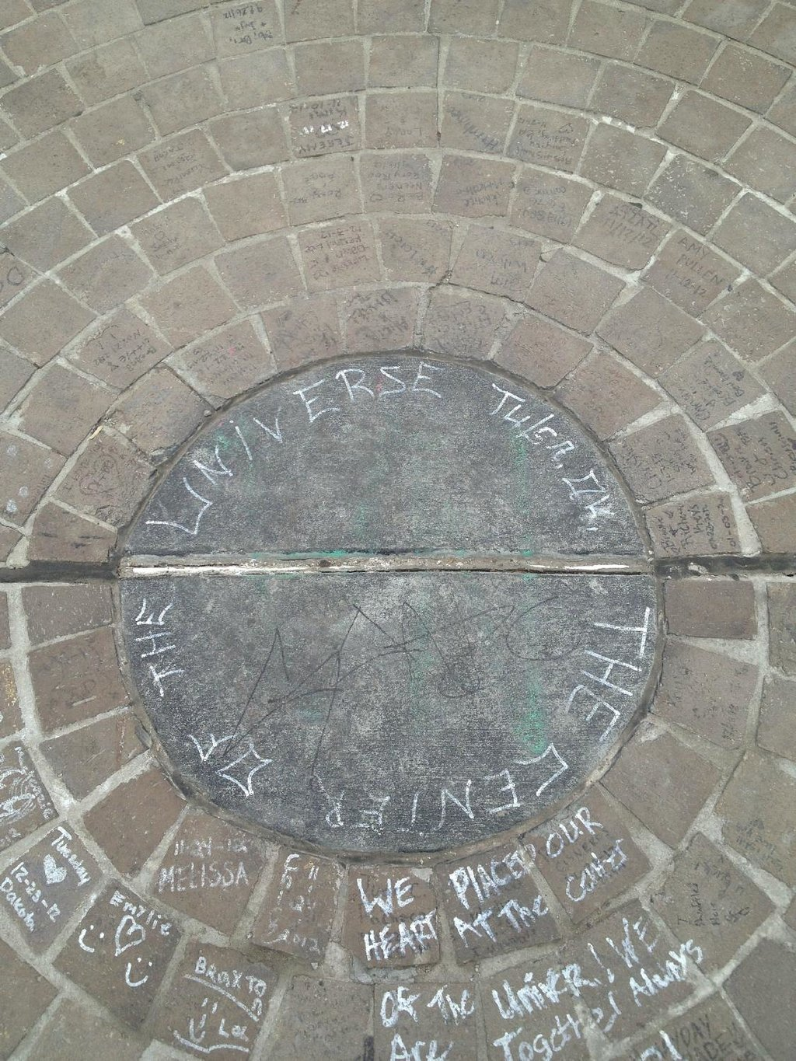

Slide 2
Faith Hope and Love
Racial Reconciliation reframed

Slide 3
Where do we start?

Slide 4
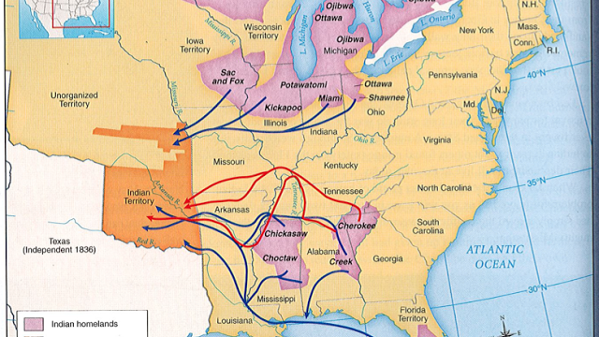

Slide 6
Detroit, Michigan Summer of 1967

Slide 7
1 Corinthians 13:1-3
If I could speak all the languages of earth and of angels, but didn’t love others, I would only be a noisy gong or a clanging cymbal. If I had the gift of prophecy, and if I understood all of God’s secret plans and possessed all knowledge, and if I had such faith that I could move mountains, but didn’t love others, I would be nothing. If I gave everything I have to the poor and even sacrificed my body, I could boast about it; but if I didn’t love others, I would have gained nothing.

Slide 8
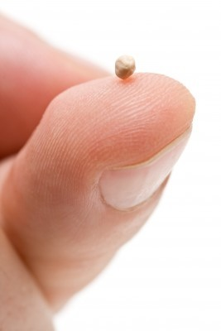
Faith grounded in love gives us a vision of what the world could be and a calling to be agents of change regardless of the obstacles in the way

Slide 9
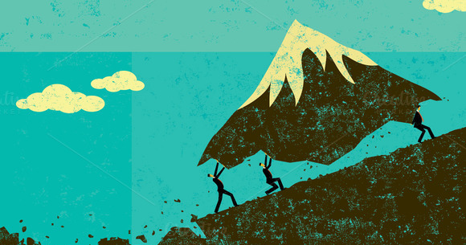
To move toward racial reconciliation what Mountains need moving in your own heart? Your congregation? Your community?

Slide 10
1 Corinthians 13 4-7
Love is patient and kind. Love is not jealous or boastful or proud or rude. It does not demand its own way. It is not irritable, and it keeps no record of being wronged. It does not rejoice about injustice but rejoices whenever the truth wins out. Love never gives up, never loses faith, is always hopeful, and endures through every circumstance.

Slide 11
Hope has two beautiful daughters; their names are anger and courage. Anger at the way things are, and courage to see that they do not remain as they are. –St. Augustine of Hippo

Slide 12
Think over the last 3 or 4 months. What has angered you with regards to race and injustice? What has given you hope? When have you had to be courageous? What fuels your courage?

Slide 13
Hope leads to a new Vision

Slide 14
1 Corinthians 13:8-10
Prophecy and speaking in unknown languages and knowledge will become useless. But love will last forever! Now our knowledge is partial and incomplete, and even the gift of prophecy reveals only part of the whole picture! But when the time of perfection comes, these partial things will become useless.

Slide 15
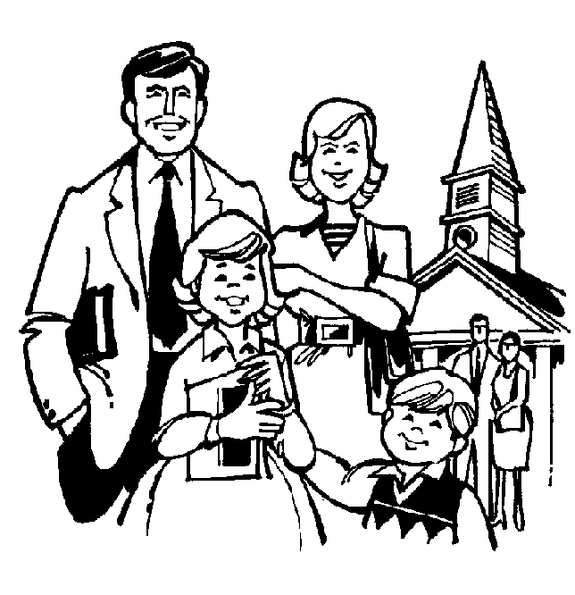
Where is our knowledge partial and incomplete?

Slide 16
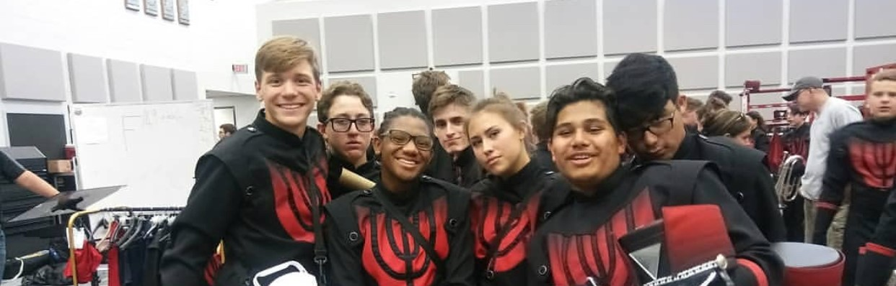
The activity of an ally is this: “to love across the artificial boundaries that society erects.”
-Rex Fowler, Activist

Slide 17
1 Corinthians 13:11-13
When I was a child, I spoke and thought and reasoned as a child. But when I grew up, I put away childish things. Now we see things imperfectly, like puzzling reflections in a mirror, but then we will see everything with perfect clarity. All that I know now is partial and incomplete, but then I will know everything completely, just as God now knows me completely. Three things will last forever—faith, hope, and love—and the greatest of these is love.

Slide 19
What aren’t we seeing?

