Slide 1
Racial Reconciliation Discipleship and Mission
New England Gathering September 2018

Slide 2
Let’s talk
about race!
Let’s talk about mission
Notes:
How many of us are here this week because you just love to talk about race in the church?
How many of us are here because you love conversations about growth and mission?
How many of you think those are the same conversations?
Should be at least some of us in the third group, because we are here, after all
at a Gathering of Leaders which is always about strong, hope-filled, vision and passion for mission and growth (the numerical kind and the spiritual kind,) and one where >>>>

Slide 3
This year, the lens we are using
to look at a growing, mission-focused church is about race
– constructed as it has been in the US – and reconciliation.
Notes:
and one where this year, the lens we are using to look for the call and reality of a growing, mission-focused church, is about race – constructed as it has been in the US – and reconciliation.

Slide 4
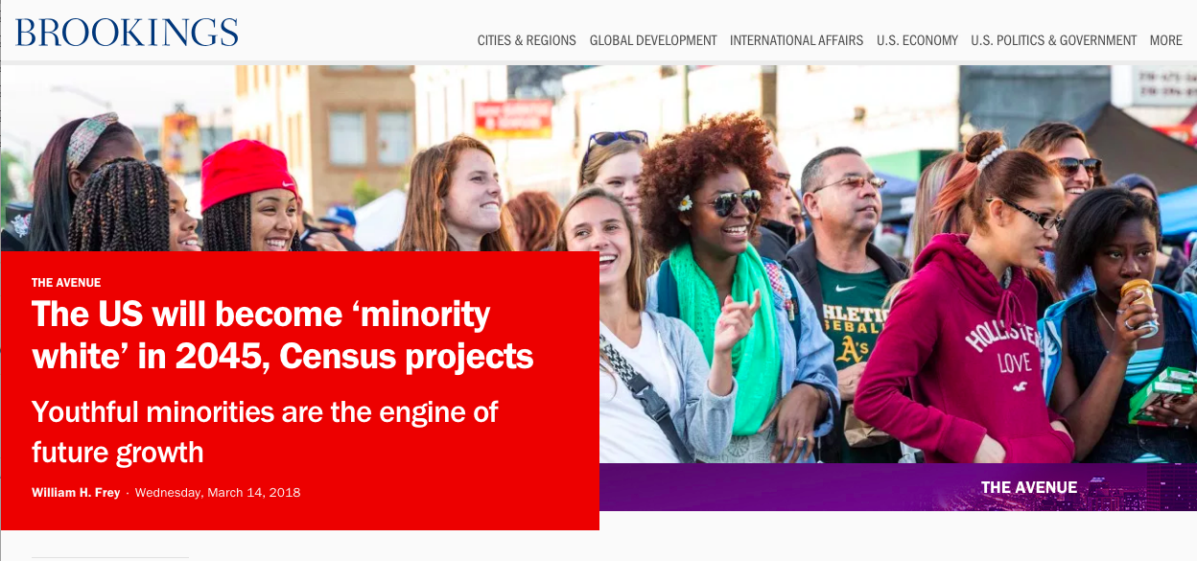
Growth may depend on our attention to race and reconciliation.
Notes:
But I’m going to flip the lens just for a second, and notice that growth in any form may depend on our attention to race and reconciliation.
[Brookings headline: US will be “minority white” in 2045]
In 2020 – just two years from now – youth up to age 18 in the US will no longer be mostly white. In seventeen years – while we’re still in active ministry – the whole US demographic will change.

Slide 5
The people available for evangelism are increasingly
younger, browner, and more radical than the evangelizers – than the church as we know it today.
Race is a growth issue.
Notes:
The people available for evangelism, for the growth of the gospel, and of the church, are increasingly younger, browner, and more radical than the evangelizers – than the church as we know it today.
In other words,
race is a growth issue.

Slide 6
Race is a growth issue.
The future of the church requires reconciling work that enables us to speak honestly in all dimensions about race,
and about the pain and sin of the human construction of “race”.
And on how we reflect the holy diversity of the reign of God in the daily life of our congregations.
Notes:
And the future of the church may very well depend on the reconciling work that enables us to speak honestly in all dimensions about race,
about the pain and sin of the human construction of “race”,
and on our ability to reflect the holy diversity – and the lack of human created barriers – of the reign of God in the daily life of our congregations.
We’re not asking a lot of ourselves this week, are we?

Slide 7
Race and reconciliation may feel a lot like “evangelism”
Overwhelming even when I’m eager
Requires vulnerability
Scary even as I long for it.
Notes:
We’re not asking a lot of ourselves this week, are we?
Racial reconciliation is probably a lot like “evangelism” in the Episcopal Church – great idea, hard to do because it’s countercultural to the early 21st century Episcopal Church – in other words, in many of the places we call home.
It’s a topic that overwhelms me even as I’m eager for it, and a commitment to vulnerability that scares me – even as I long for it.
Anyone else?

Slide 8
The Big Ask for this week
Vulnerability and longing for reconciliation
Eagerness for the gospel that embraces that overwhelming feeling without denial.
Notes:
I think that’s the big ask we are making of ourselves for these next couple days: vulnerability and longing for reconciliation;
eagerness for the gospel that embraces that overwhelming feeling without denial.
I'm not here because I know where we are going from here,
but I can tell you a bit about how we got here.

Slide 9
How did we get here?
themes that help active, creative, leaders in the church think about what shapes how we proclaim the gospel
timely.
This theme responds to
the call of our Presiding Bishop
and the 2015 General Convention’s call for more anti-racism work and resources.
Notes:
The Gathering of Leaders Steering Committee makes an effort to find themes that help active, creative, youngerish leaders in the church think and talk about aspects of our common life that shape how we proclaim the gospel,
and are at least somewhat timely.
So discussion of this theme started in 2016, if not sooner,
in part in response to the call of our (then recently elected) Presiding Bishop for attention to racial reconcilation,
and the 2015 General Convention’s call for more anti-racism work and resources.
But for me there’s another piece to the story.
How many of us have been to a Gathering of Leaders event before?

Slide 10
At your first Gathering of Leaders
what did you see?
who did you see?
Notes:
How many of us have been to a Gathering of Leaders event before?
Do you remember looking around, and taking notice of who was in the room and who was not?
I suspect I’m not the only one who looked around at my first gathering to find out whether I “belonged” in the room. No?
Or if this is your first Gathering with us, did you “look around” before you came to find out whether you’d “belong” in the room
CLICK TO DUPLICATE SLIDE FOR MORE NOTES

Slide 11
At your first Gathering of Leaders
what did you see?
who did you see?
Notes:
At my own first Gathering (in 2010), I noticed that the room seemed pretty male, straight, and Texan. A lot of that has changed.
But it took me a while to see the whiteness of the room,
and I didn’t feel that someone was missing, until I’d been to a Gathering that was more diverse in color and race, thanks to my colleague Jemonde who went recruiting.
I didn’t - maybe couldn’t – see how much the room was like me and excluded someone else until the room changed.
DUPLICATE SLIDE WITH MORE NOTES

Slide 12
At your first Gathering of Leaders
what did you see?
who did you see?
Notes:
But after that, the whiteness of the room began to feel painful to me.
I kept feeling like something was missing; like we weren’t quite whole;
and because I did, I started hearing what other people feeling that distress were saying. Several other Steering Committee members – as well as lots of Gathering participants and invitees – were having the same experience – and that helped me want to change.

Slide 13
Until we feel the pain – truly feel brokenness or incompleteness, miss the people who are missing, we won’t evangelize, and we won’t heal.
Notes:
A wise friend pointed out to me recently that until we feel the pain – until we truly feel sense of brokenness or incompleteness, the loss of the people who are missing from our community, we won’t evangelize, and we won’t heal.
That’s true of reconciliation, too.
I mean, ever since childhood, I’ve learned to voice an apology for things I don’t actually regret in order to smooth things over.

Slide 14
Reconciliation
requires repentance, requires a change of heart
requires feeling the pain my sin causes me,
so my heart begins to change, able to make amends
ask to repair the relationship; ask forgiveness.
Notes:
since childhood, I’ve learned to voice an apology for things I don’t actually regret in order to smooth things over.
But actual reconciliation requires repentance, requires a change of heart,
requires feeling the pain my sin causes me, before my heart begins to change, and I am able to make amends and ask to repair the relationship; ask forgiveness. Reconciliation of sin of racism so important to the church, bc process of reconciliation is change of heart and behavior

Slide 15
How or when did race/ethnicity in the church become personal for you? How did your heart change?
Notes:
So let me ask you:
how or when did race in the church become personal for you? Or your community? how did you begin to feel the loss, the pain of who was missing?
Think about it for a minute or two
Those stories are going to differ significantly around the room so I want us to hear someone else’s story Tell someone Doesn’t have to be the person next to you.

Slide 16
How or when did race/ethnicity in the church become personal for you? How did your heart change?
Notes:
I’m In these stories are ways individuals and communities are motivated for reconciliation. So I’m going to be listeing for these stories over the next few days, for ways motivation and change of heart are evoked; ways church can begin to feel what’s missing, change their hearts, and long for this work among ourselves and in the world and culture we live and work in

Slide 17
How or when did race/ethnicity in the church become personal for you? How did your heart change?
Listen for these stories
Notes:
I’m going to be listening for that, because the Gathering of Leaders is usually a place to take home practical inspiration for growth and mission,
and because this question about how we notice what’s missing, how we feel the urgency, is explicitly an evangelism question, too.

Slide 18
Evangelism, too
How do we notice who’s missing? How do we feel the urgency?
We don’t reach out and tell the gospel story and share the grace
with people who aren’t already among us
if we don’t feel the pain of their absence.
Notes:
this question about how we notice what’s missing, how we feel the urgency, is explicitly an evangelism question, too.
We don’t reach out and tell the gospel story; share the grace, with people who aren’t already among us, if we don’t feel the pain of their absence.
I'll be listening for one other thing, too.

Slide 19
Competence
Doubt of our own competence (or of others!) can hold us back from reconciliation,
from addressing the sin of racism,
or from evangelism and growth,
even once we feel the need, the urgency, and the pain.
Notes:
I’m going to be listening for competence building tools, too.
Because doubt of our own competence – or of others competence -
is one thing that often holds us back from reconciliation, from addressing the sin of racism, or from evangelism and growth,
even when we feel the need, the urgency, and the pain.
From a lot of perspectives, and for a lot of different reasons, a growing, vital church, the reign of God, and the work of racial reconciliation can look overwhelming.

Slide 20
Competence
You can build competence
And you can borrow competence
Notes:
To my surprise, I have found the mandated anti-racism training builds my own competence – I learn history and vocabulary that let me feel like I can enter the conversation, and that help me feel I can actually hear when I listen. So I can see ways to advocate and barriers I can help remove
And I’ve found that I can borrow competence.
I can borrow my competence in preaching and teaching and parish administration and at navigating the Gathering of Leaders format – to ask questions or take small actions that terrify or overwhelm me outside of those areas of competence.

Slide 21
Tools of Competence
Building the knowledge and awareness of history and reality a few coffee hours and classes at a time
I don’t know how to fight racism, but I do know how to throw a children’s party
I don’t know how to understand structural racism, but I do know how to write to my congressperson.
Notes:
We’re doing this in a small way at Trinity.
Our “God’s Diversity Committee” is committed to building knowledge and awareness of the history and present reality of racism in the world and the church – a few coffee hours and evening events at a time – as well as helping people see some of the richness we are missing, and to long for it. And I do see parishioners begin to be more confident and competent in asking questions, identifying their longing for what’s missing among us, and volunteering actions – borrowing their competence at throwing parties or teaching Sunday School to try vulnerable conversations.

Slide 22
Tools of Competence
what has helped to build your sense of competence, or that of your congregation/ministry, to address the gaps between our longing and the kingdom of God?
What competence do you already have that you can “borrow” for the work of racial reconciliation? for the work of evangelism?
Notes:
So let me leave you with one more question:
what has helped to build your sense of competence, or that of your congregation/ministry, to address the gaps between our longing and the kingdom of God?
What competence can you “borrow” for the work of racial reconciliation? for the work of evangelism?
[?? share with one other person]

Slide 23
Thy kingdom come….
Keep listening for the stories of longing
Learn to evoke those stories
Keep looking for tools of competence, built or borrowed.
Notes:
I invite you to keep looking and listening these next couple of days for the stories of need and longing, and how we evoke those, and for the tools that build competence in the actions and of racial reconciliation.
Because those are the building blocks of the reign of God, of the mission we are called to, in partnership with Jesus.

Slide 24
Racial Reconciliation Discipleship and Mission
New England Gathering September 2018

