Slide 1
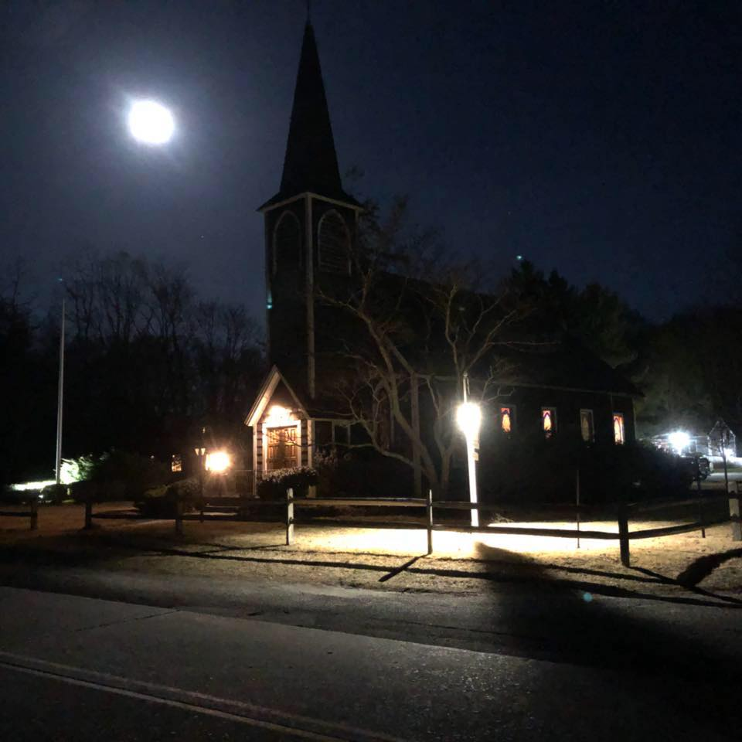
St. James, Brookhaven
Notes:
St. James in the Woods 65 miles east of NYC. Tell the story of taking this picture.

Slide 2
In the beginning there was
BROOKLYN
Notes:
I’m a child of Brooklyn. Haitian immigrants. The diversity

Slide 3
Brooklyn is the Center of the Universe!
Notes:
Brooklyn would be the 3rd biggest city after LA and Chicago
Different neighborhoods Bensonhurst – Italian Crown Heights/Est Flatbush Caribbean, East NY Black and Latino. Bed Stuy used to be Black. Sunset Park Latino, Asian, the Heights and Slope mostly white. 2 train experience There were no white who got off from President St- Flatbush.

Slide 4
Michael Griffith
Notes:
1986 – Michael died fleeing from a Mob in Howard Beach, Queens. Car broke down, they walked 3 miles to They yelled the N word yielded bats – forcing him to run onto the Belt Parkway and hit by a car.

Slide 5
Yusef Hawkins
Notes:
Bensonhurst Brooklyn. The B6 ends there. Went to buy a used car, because a black or latino man was dating a white woman.

Slide 6
Central Park 5
Notes:
Jogger attack

Slide 7
Central Park 5
Antron McKray
Kevin Richardson
Yuseef Salaam
Raymond Santana
Korey Wise
Notes:
They were my age.

Slide 8
Notes:
A real estate tycoon. Called for the death penalty. Many of us saw this as a call for mob justice – bringing lynching into this generation.

Slide 9
NYC and Long Island
Notes:
Geography of Long Island & NYC

Slide 10
Diocese of Long Island
Brooklyn
Queens
Nassau
Suffolk

Slide 12
Notes:
85% White. Wedding – Mother of the bride

Slide 13
Suffolk County
Notes:
Political leanings of Suffolk.

Slide 14
Brookhaven
Notes:
Hamlet of Brookhaven - exurban

Slide 15
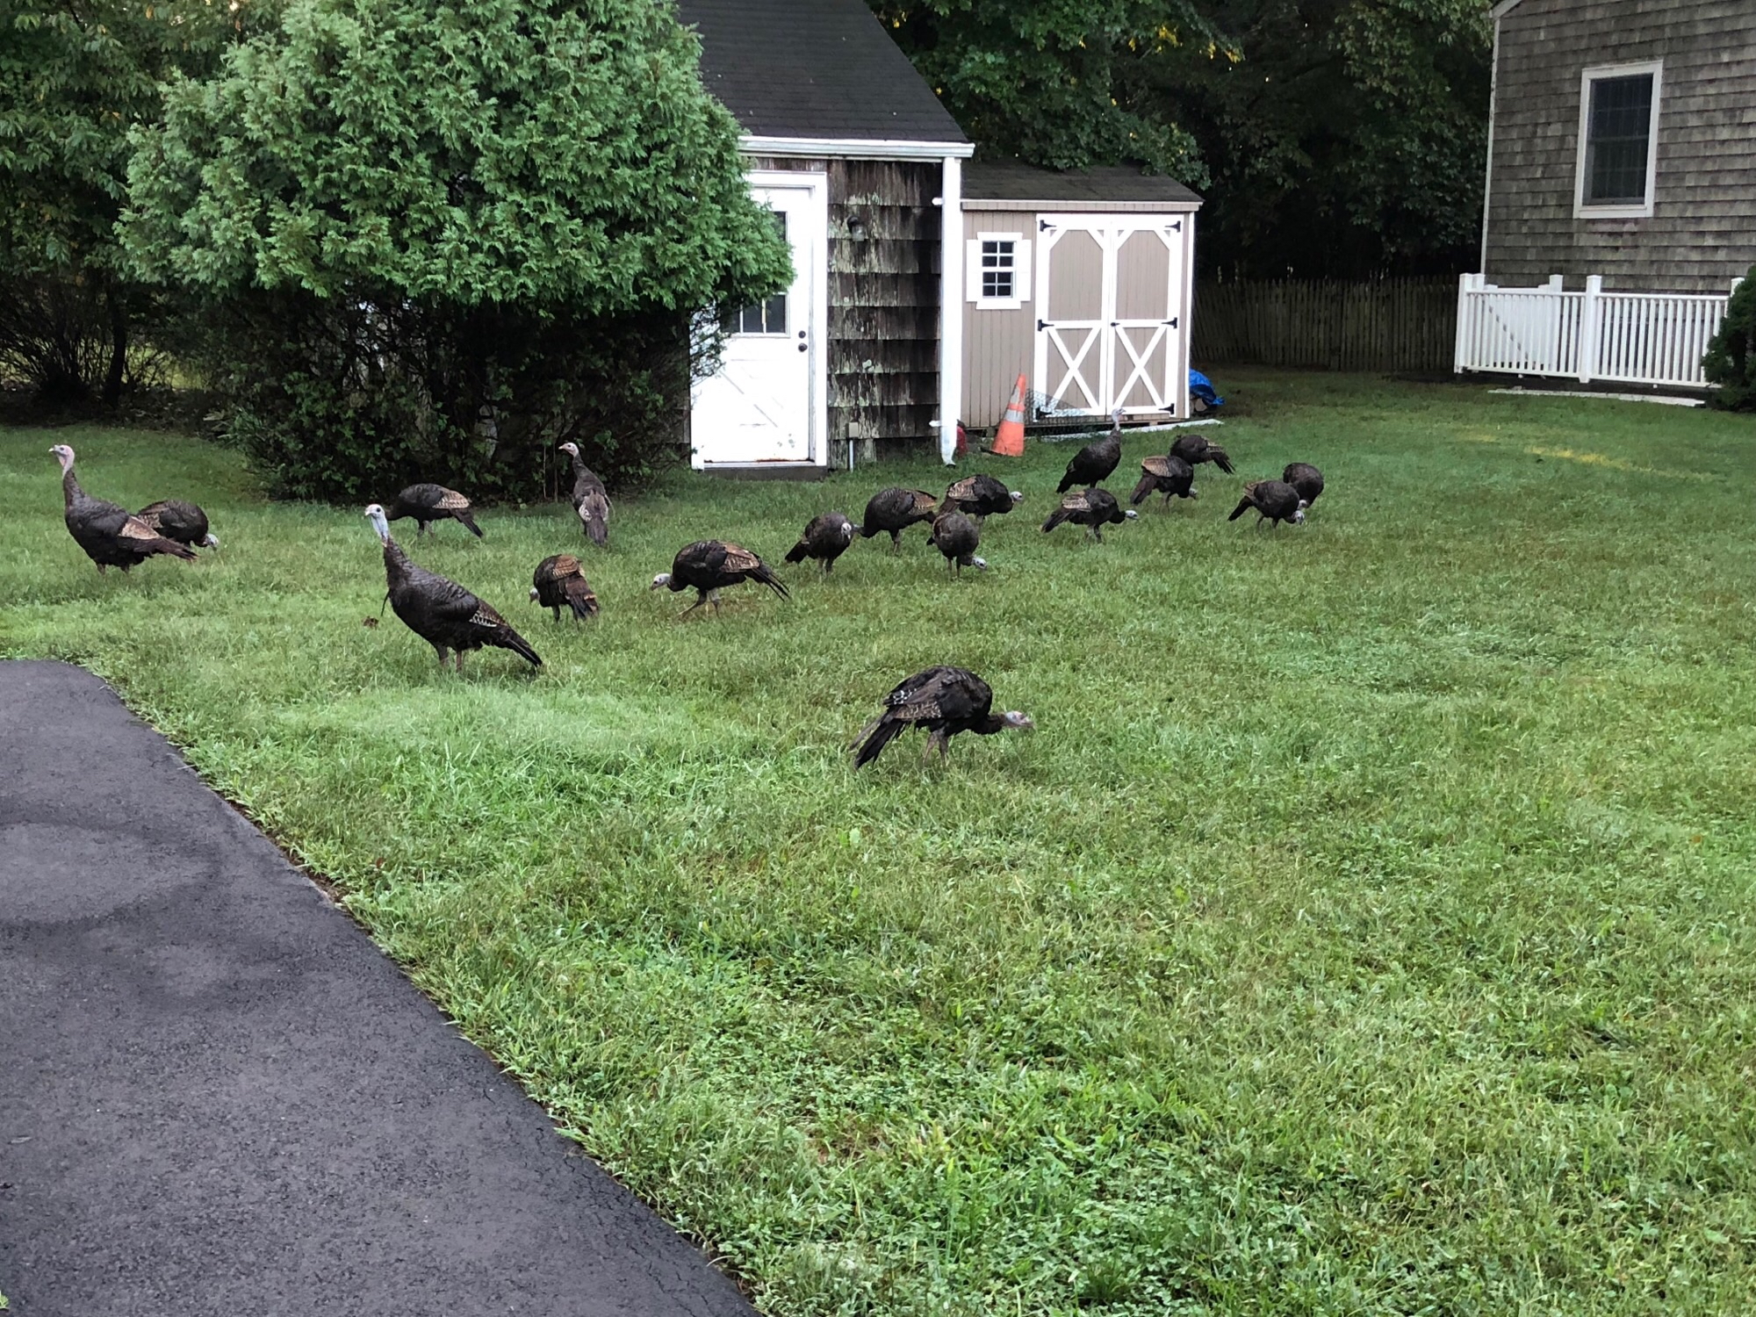
Brookhaven
Notes:
Most of it is the Werthiem National Preserve. Post Morrow Foundation. St. James Edgar Ave. property forever green.

Slide 16
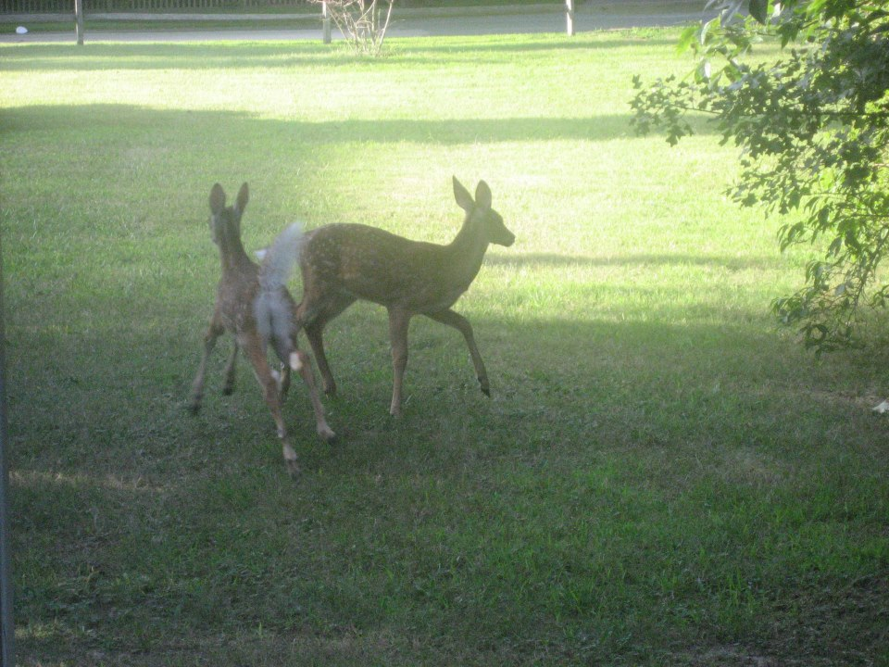
Brookhaven
Notes:
If only we had as many deer as people.

Slide 17
First Day of Orientation September 1997 Seabury-Western Theological Seminary
Notes:
10 out of 22 of us were people of color. Diversity was celebrated.

Slide 18
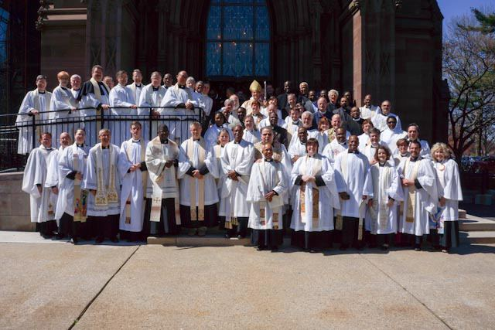
Clergy at Chrism Mass
Notes:
LI was the same way.

Slide 19
Notes:
Shared this on Church’s FB page in 2013. A reminder of how divided we are.

Slide 20
Racial Justice and Reconciliation Committee

Slide 21
Notes:
3 Episcopal Churches + 1 Lutheran Church Read as our Lenten Study in 2017.

Slide 22
Notes:
Birthday celebration It’s always

Slide 23
Notes:
Diversity of congregation – 10 different zip codes

Slide 24
Notes:
We had 3 black families. Alexandres were the 4th. 4 more. 3 interracial couples, 1 Indian from Guyana. We’ve become more diverse

Slide 25
CORE
Community of Reconciling Episcopalians
Will you seek and serve Christ in all persons loving your neighbor as yourself?
Will you strive for justice and peace among all people and respect the dignity of every human being?

Slide 26
Notes:
Star Trek. TOS – Let That Be Your Last Battlefield Enterprise -Terra Prime episode Seeing Selma Showing Zootopia Video from Christ Church Cathedral, Indianapolis – Sharing our Stories: Christ Church Cathedral responds to a Summer of Racism.

Slide 27
Notes:
Ethnic and Cultural Heritage Dinner – We like to eat!

Slide 28
Notes:
Reflecting this in the preaching. The week before doubting week of Trump going on about the Birth Certificate and they finally showed it. I asked if his father was from Germany or Norway, would there be doubts. Thomas The week Zimmerman acquitted, the next week the reading was Good Samaritan. He did not see Travyon Martin as a neighbor.
The week of the S-hole countries, The sermon asked the question can anything good come out of El Salvador, Africa, Haiti.

Slide 29
Notes:
The story of this picture. 2 Easter Sermon. The struggle continues. Stephon Clark. One of the police officers made sure to tell me he had a record.

