Slide 1
Gathering of Leaders
Entrepreneurial Visionary Leaders
in the
Missionary Church
August 12, 2019
The Reverend Ronald C. Byrd, Sr.
The Episcopal Church
Missioner for Black Ministries

Slide 2
Entrepreneurial Missional Leaders
What Does it mean to be Entrepreneurial?
The Reverend Ronald C. Byrd, Sr.

Slide 3
Entrepreneurial Missional Leaders
Ten skills you need to have as an entrepreneur:
Curiosity…
Time management. ...
Strategic thinking. ...
Efficiency. ...
Resilience. ...
Communication. ...
Networking. ...
Finance…
Answer by Mario Peshev, CEO of DevriX and SME Digital Consultant
The Reverend Ronald C. Byrd, Sr.

Slide 4
Entrepreneurial Missional Leaders
An Entrepreneur
“a person who starts a business and is willing to risk loss in order to make money or accomplish a goal”
“... If there's no real business or risk, you're not an entrepreneur.”
The Reverend Ronald C. Byrd, Sr.

Slide 5
Entrepreneurial Missional Leaders
What is entrepreneurial thinking?
“Entrepreneurial thinking is the ability to see the world differently than others.”
“It is like a state of mind that opens your eyes to new opportunities possibilities.”
The Reverend Ronald C. Byrd, Sr.

Slide 6
Entrepreneurial Missional Leaders
What Does it mean to be MISSIONAL?
The Reverend Ronald C. Byrd, Sr.

Slide 7
Entrepreneurial Missional Leaders
Missional:
"It is a comprehensive conversation about God, the church, and what God has sent the church into the world to be and do.”
Steven Hovater
The Reverend Ronald C. Byrd, Sr.

Slide 8
Missional Entrepreneurial Ministry
Missional:
“We have come to see that mission is not primarily an activity of the church. Rather, mission is the result of God’s initiative, rooted in God’s purposes to restore and heal creation.”
Darrell Guder, ed. Missional Church: A Vision for the Sending of the Church in North America
The Reverend Ronald C. Byrd, Sr.

Slide 9
Missional Entrepreneurial Ministry
12 Hallmarks of a Missional Church:
1. The missional church proclaims the gospel.
2. The missional church is a community where members
learn to become disciples of Jesus.
3. The Bible is normative in this church’s life.
4. The church understands itself as different from the
world.
The Reverend Ronald C. Byrd, Sr.

Slide 10
Missional Entrepreneurial Ministry
12 Hallmarks of a Missional Church:
5. The church seeks to discern God’s specific missional
vocation for the entire community
6. A missional community is indicated by how Christians behave toward one another.
7. It is a community that practices reconciliation.
8. The community hold themselves accountable to one
another.
The Reverend Ronald C. Byrd, Sr.

Slide 11
Missional Entrepreneurial Ministry
12 Hallmarks of a Missional Church:
9. The church practices hospitality.
10. Worship is the central act of the community.
11. This community has a vital public witness.
12. The church itself is an incomplete expression of the
reign of God.
Frost and Hirsch, These hallmarks can be found in Treasure in Clay Jars, Ed. Lois Barrett
The Reverend Ronald C. Byrd, Sr.

Slide 12
Gathering of Leaders
Missional Entrepreneurial Ministry
August 13, 2019
The Reverend Ronald C. Byrd, Sr.

Slide 13
Supporting caregivers,
and their loved ones . . .
The Reverend Ronald C. Byrd, Sr.

Slide 14
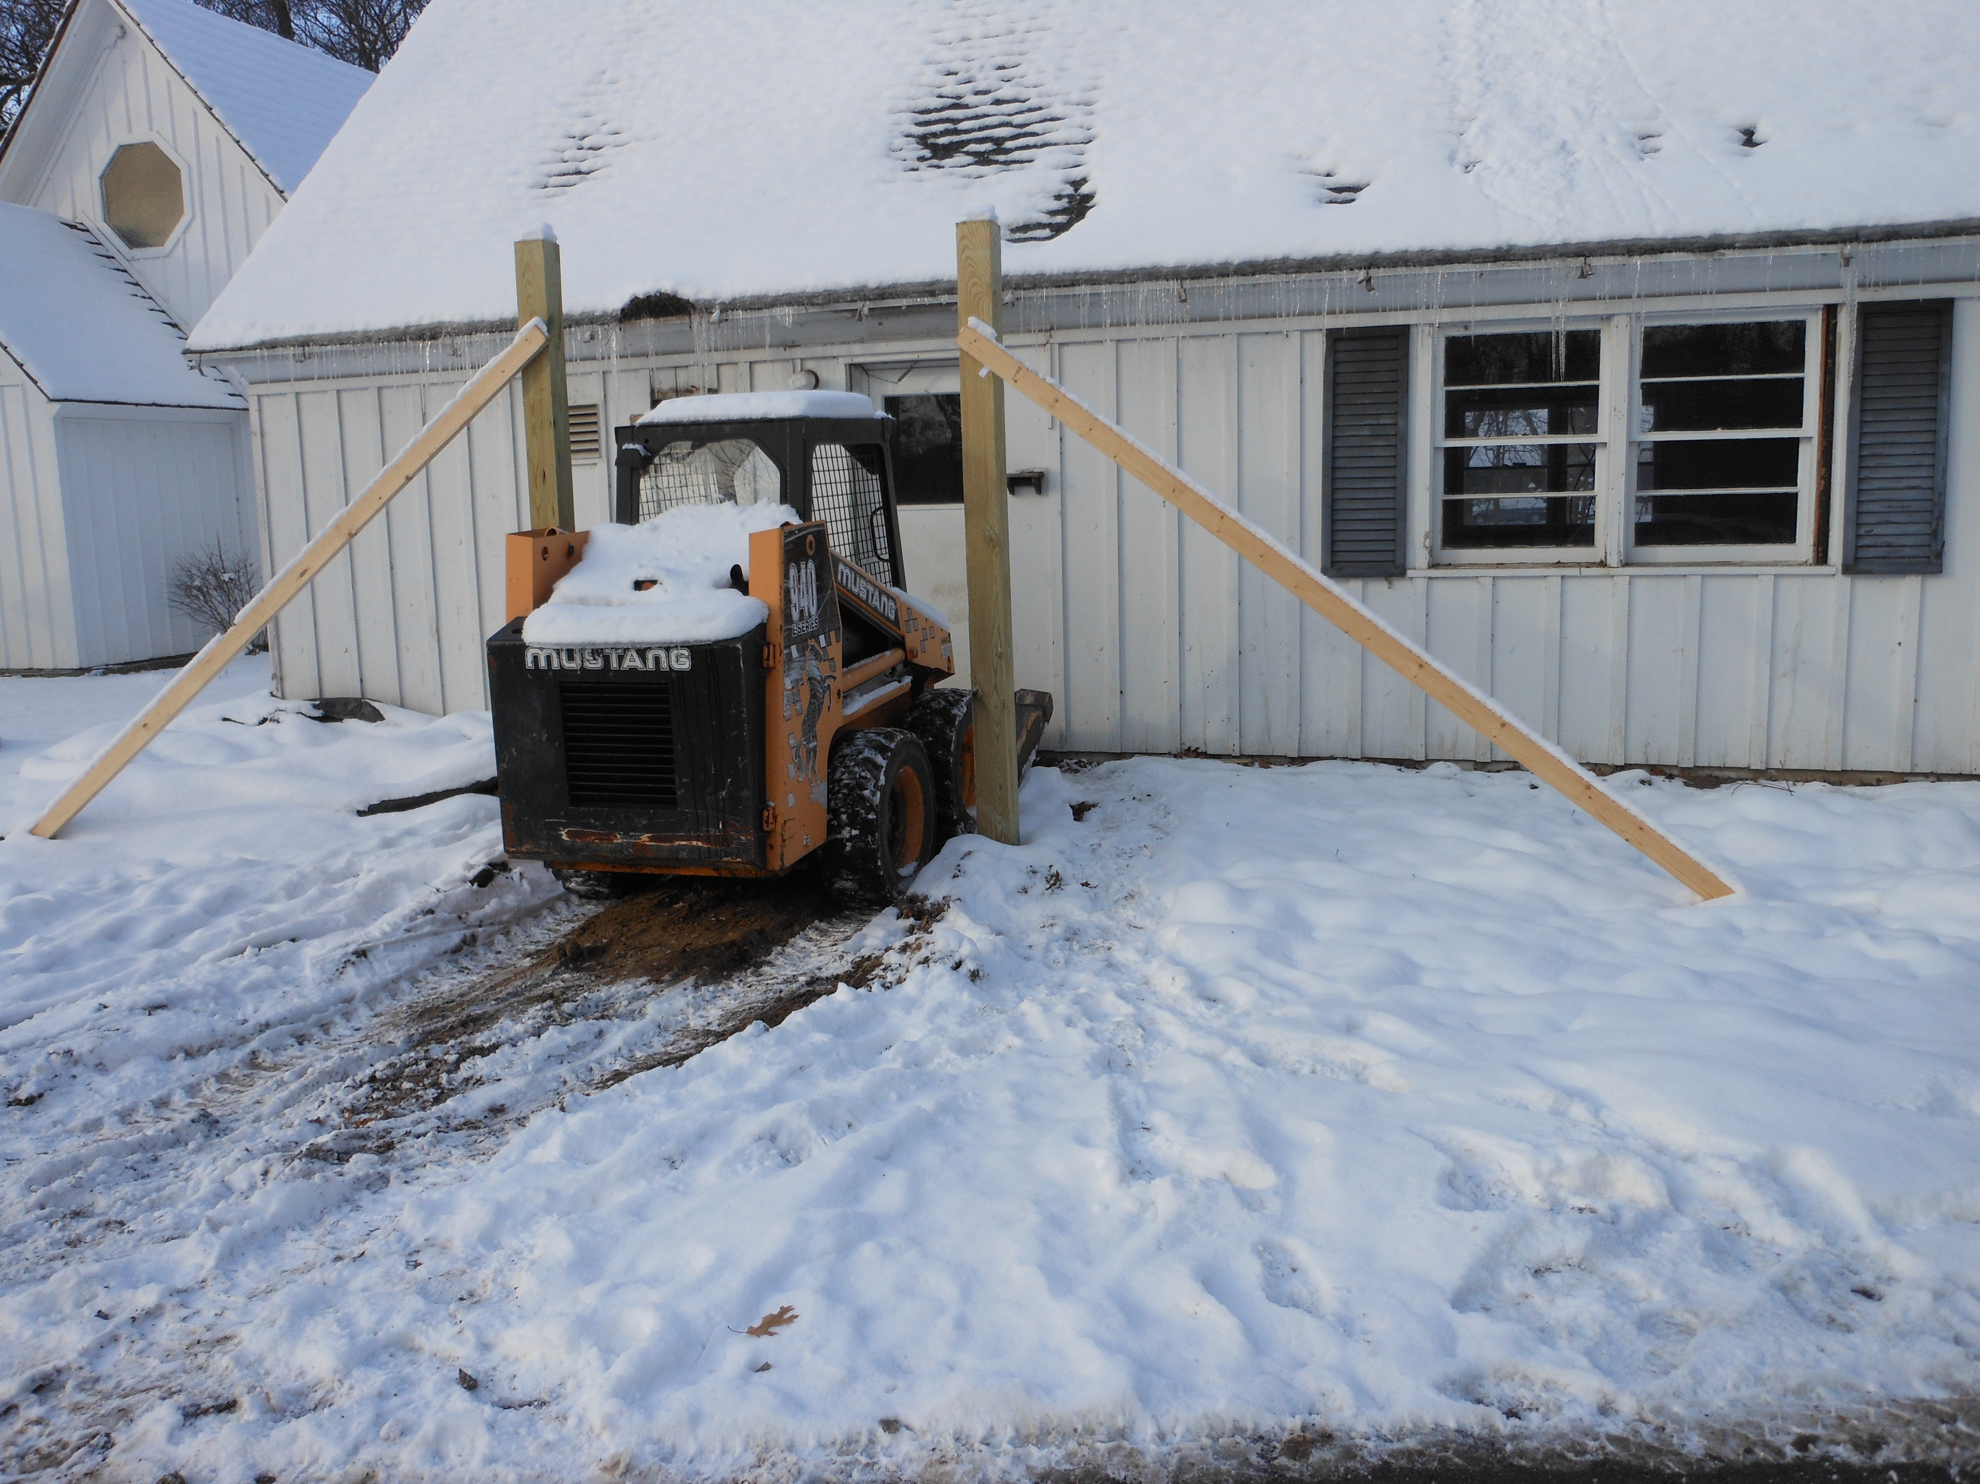

Slide 15
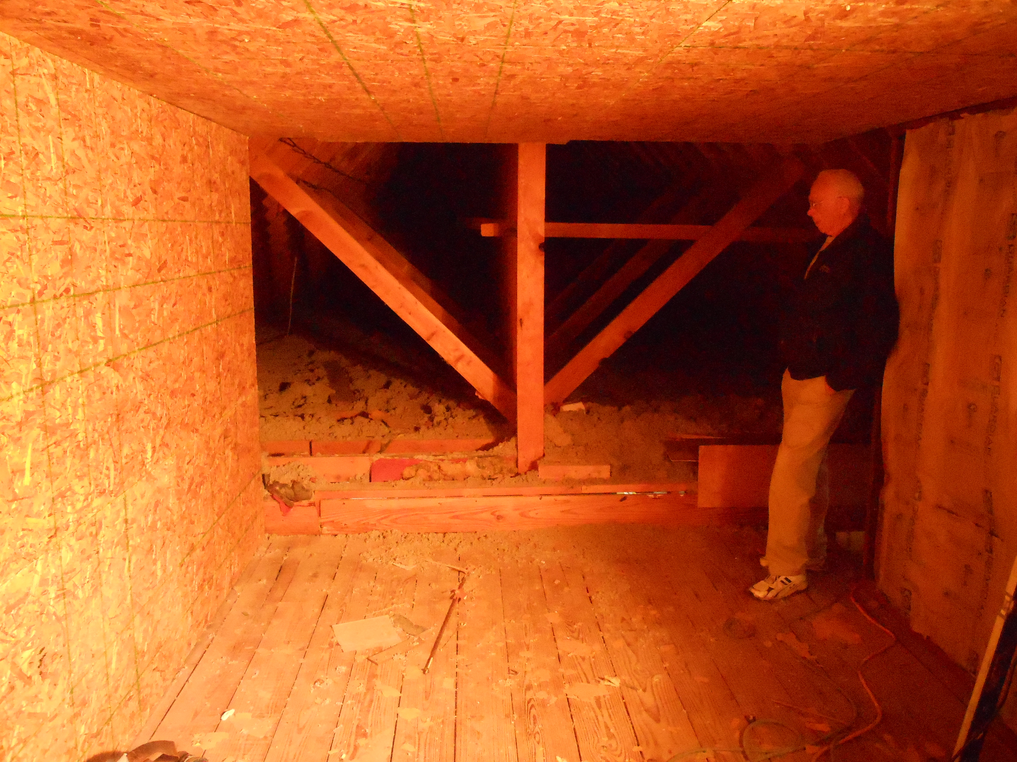

Slide 16
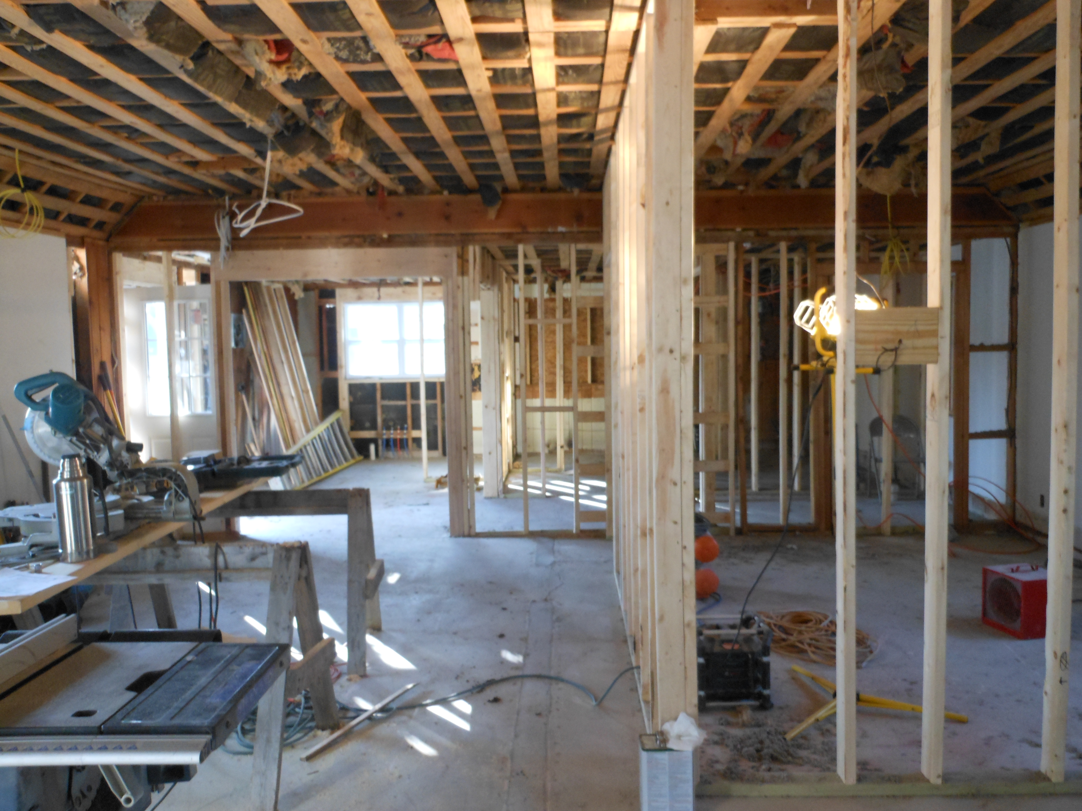

Slide 17
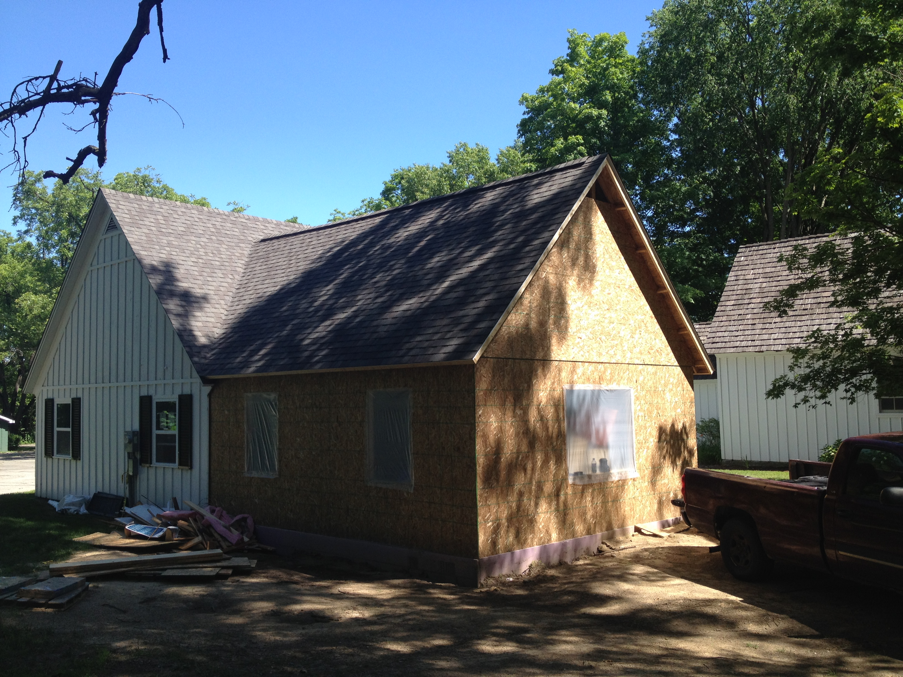

Slide 18
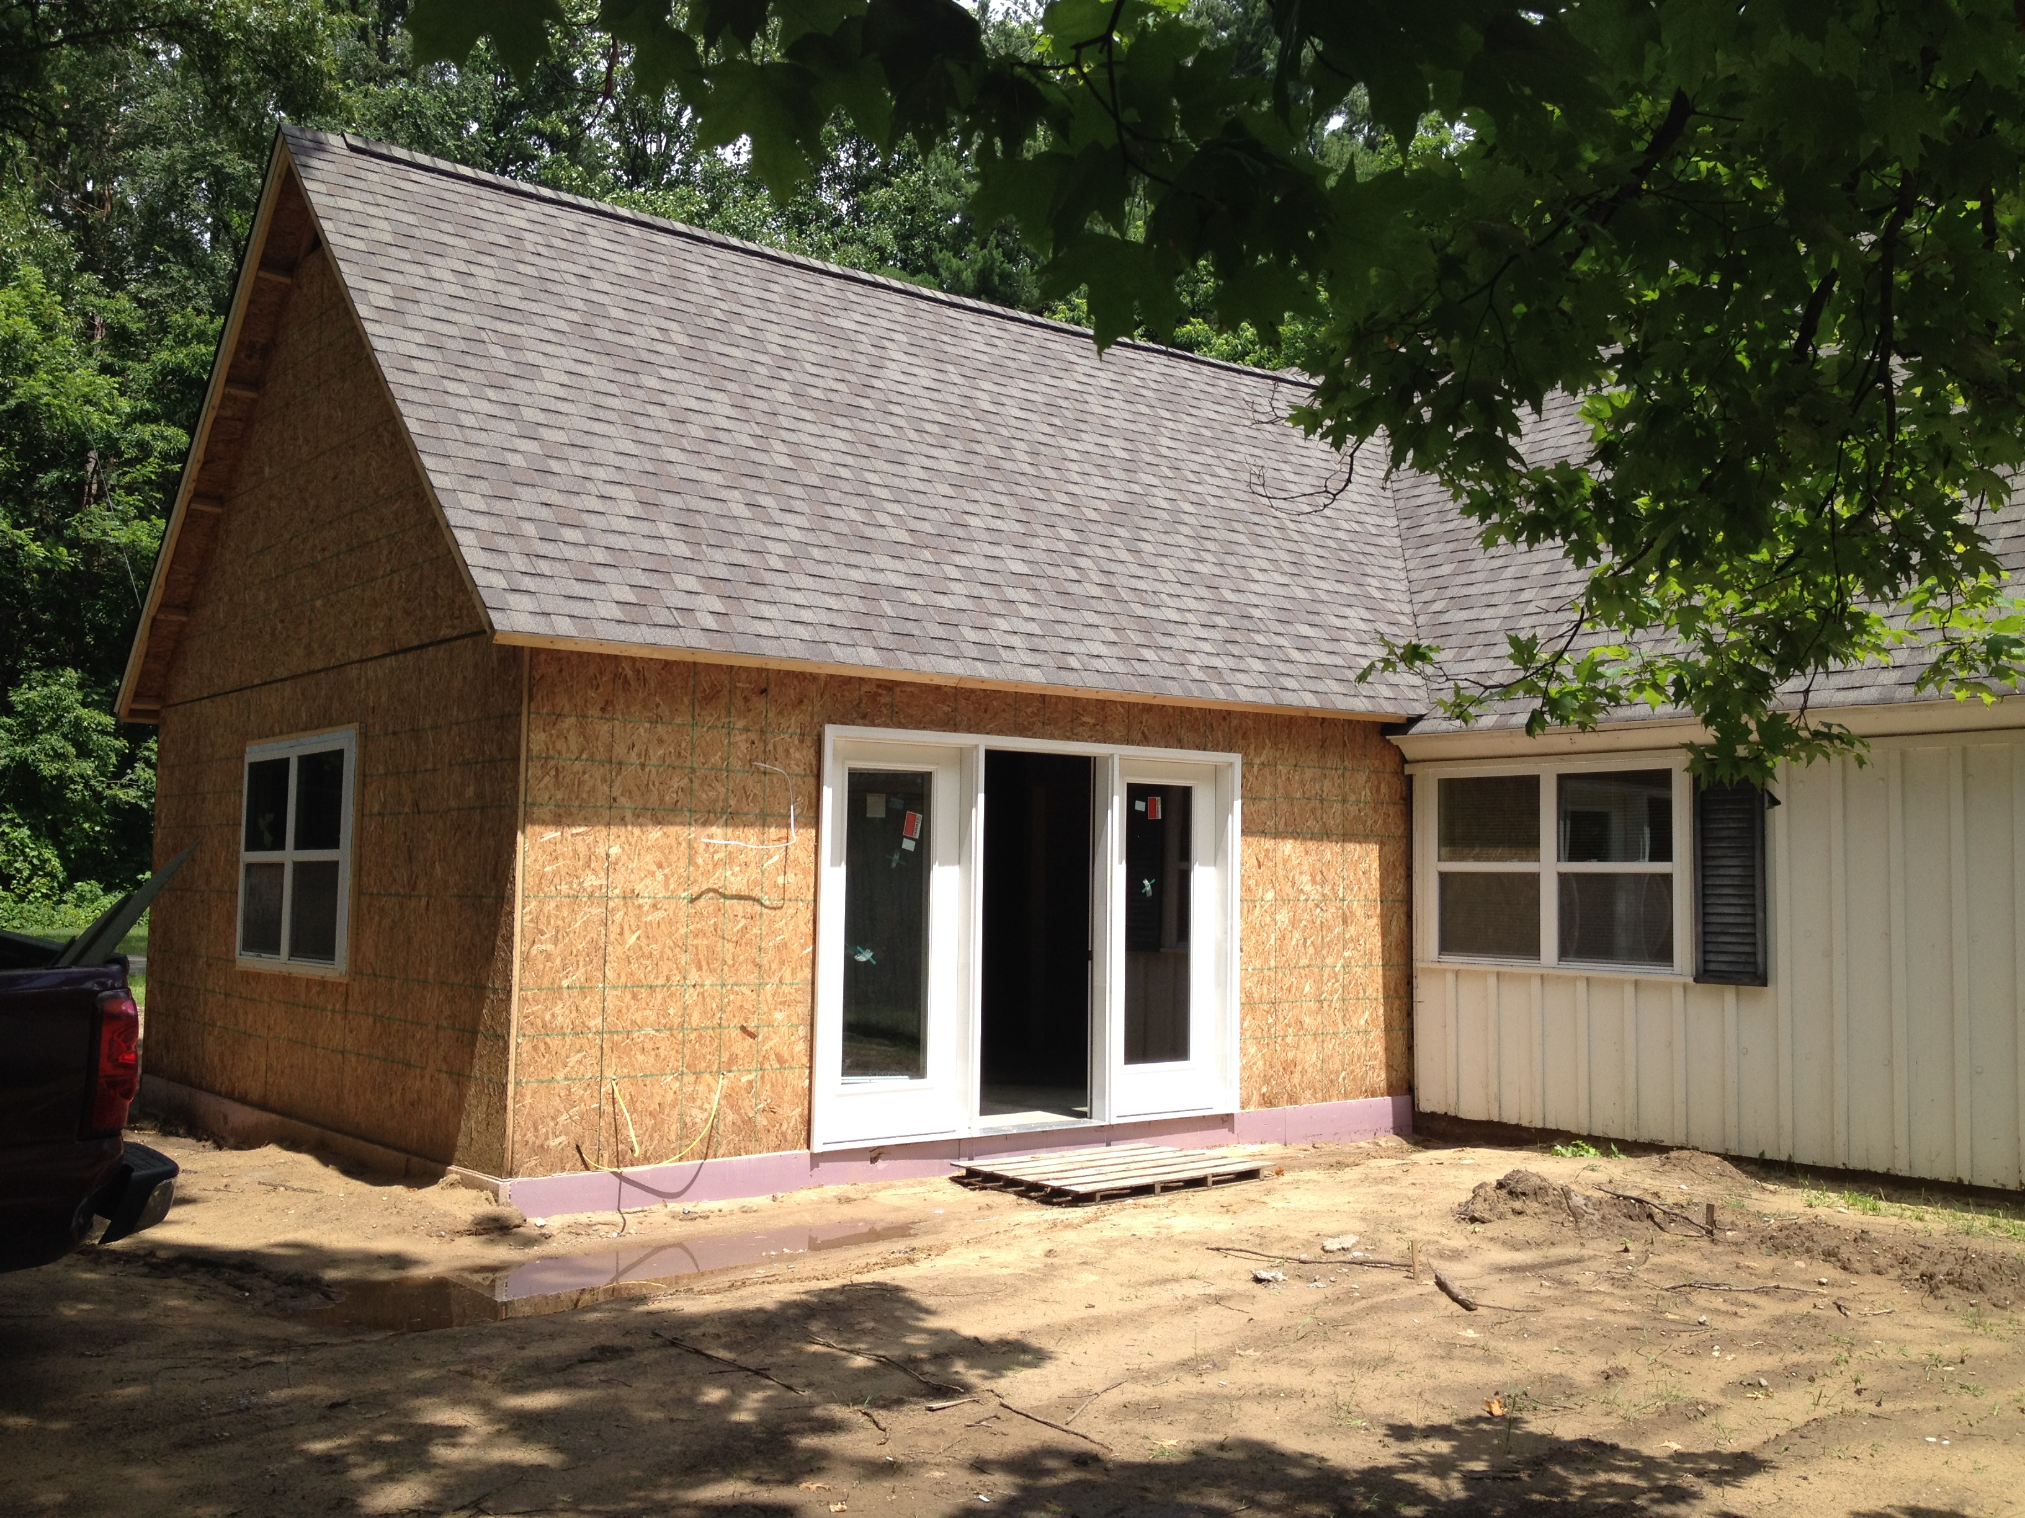

Slide 19
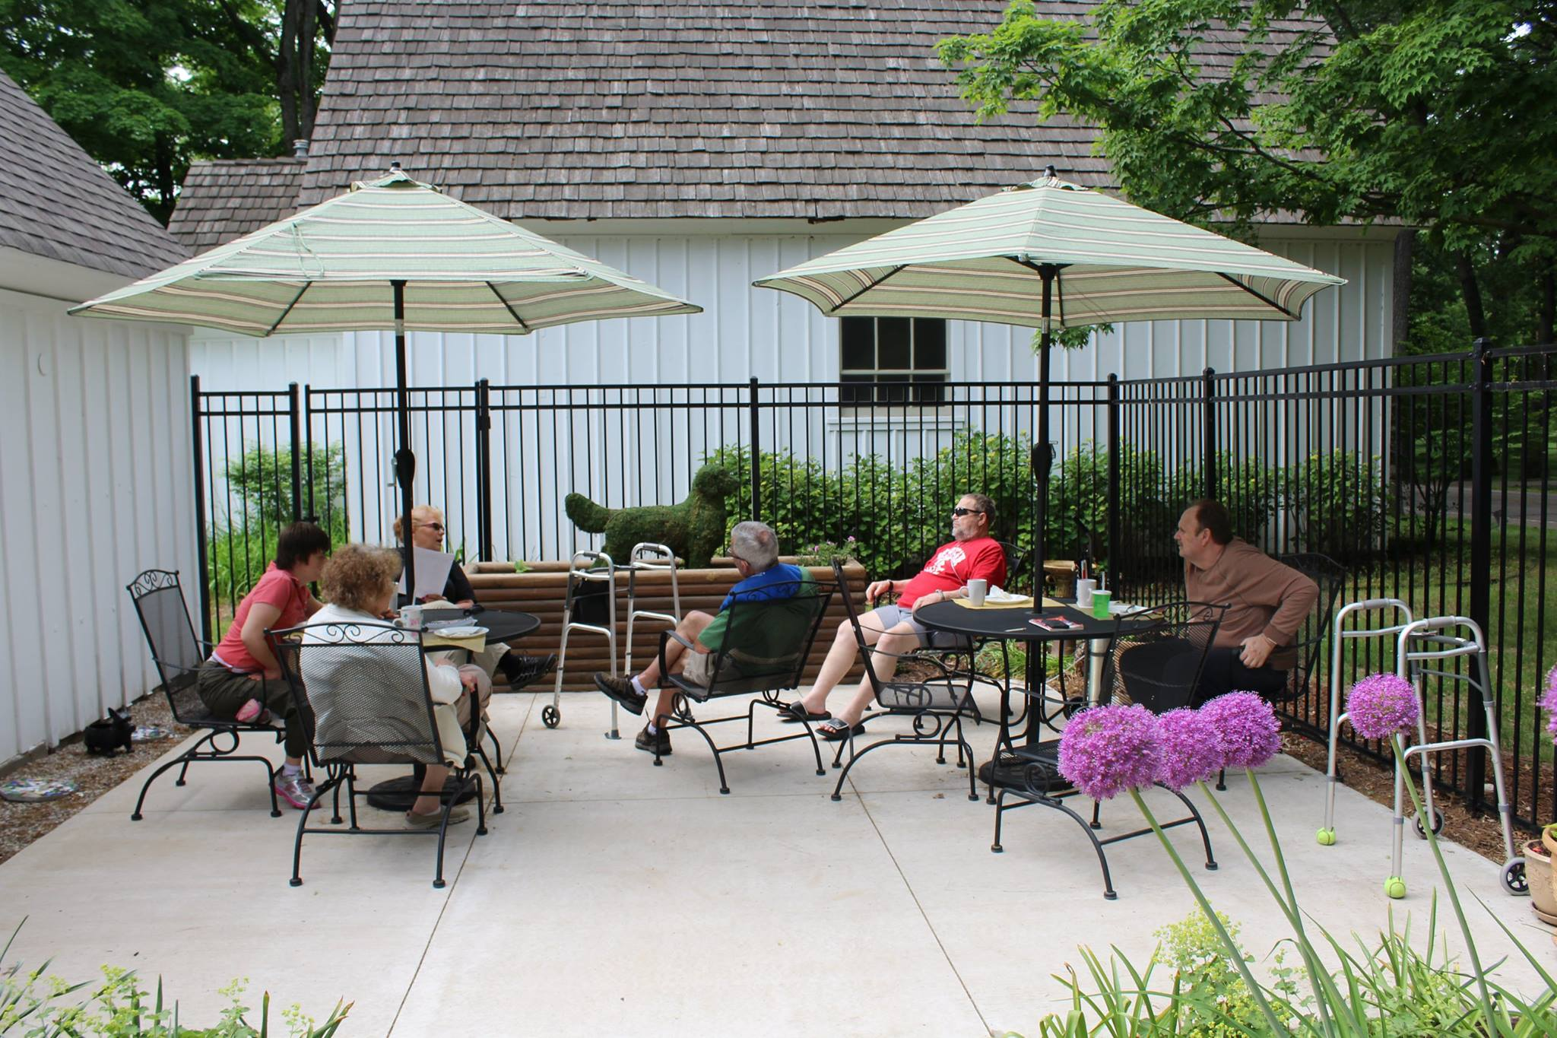

Slide 20
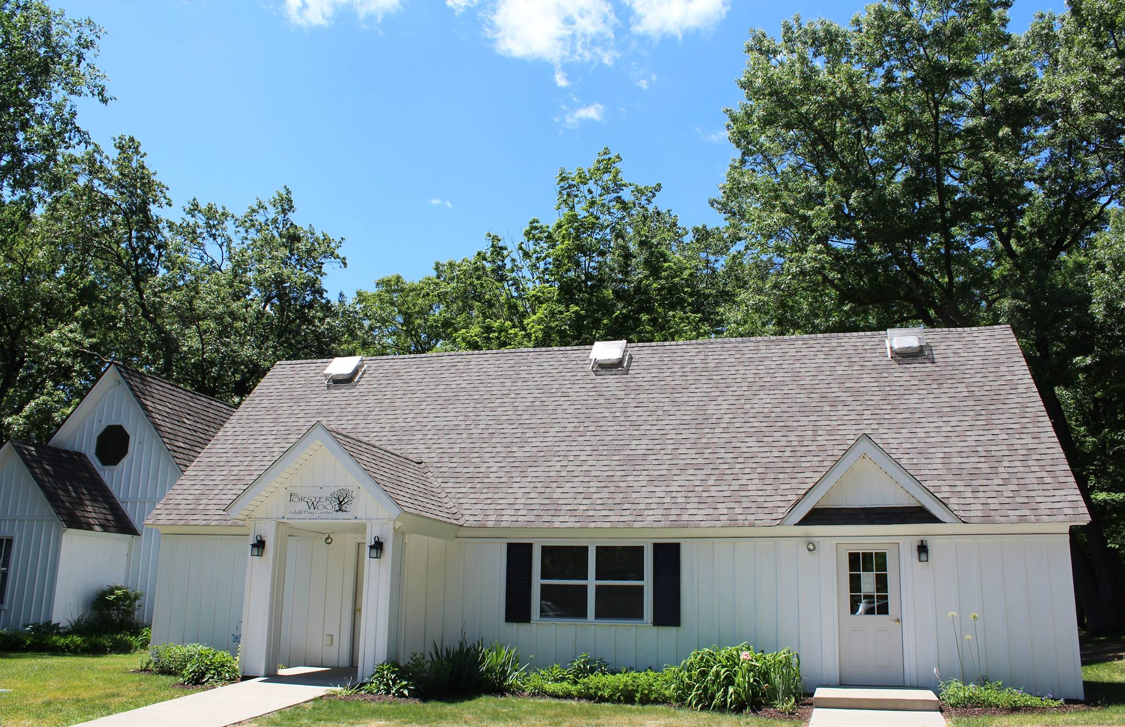

Slide 21
Our Mission
Supporting caregivers,
and their loved ones . . .
To support caregivers and their loved ones by providing a safe, comfortable and reliable day service for adults who require assistance with daily living activities and would benefit from a compassionate environment with opportunities for socialization.
The Reverend Ronald C. Byrd, Sr.

Slide 22
Forster Woods offers the following services:
Supporting caregivers,
and their loved ones . . .
Assistance with Activities of Daily Living
Transportation Coordination through CATA Spec-Tran or Redi-Ride
Personalized Care Plan
Program designed to provide cognitive, sensory, and creative stimulation
Music and Exercise Activities
Animal Therapy
Community Visitors and Outings
Individualized, nutritious breakfast, lunch, snacks and beverages
Medication Monitoring
Wellness Program with Weekly Nurse Visit
The Reverend Ronald C. Byrd, Sr.

Slide 23
Location and Hours
Supporting caregivers,
and their loved ones . . .
The Forster Woods Adult Day Center facility is located at 4656 N. Meridian Road on 10½ acres of gardens and woods in the midst of a residential area west of Williamston, Michigan. Forster Woods is easily accessible from Williamston, Haslett, Okemos, and East Lansing.
Our program offers flexible hours and operates Monday through Friday from 7:30 a.m. until 5:30 p.m. To accommodate the needs of our caregivers, Saturday hours are available upon request.

Slide 24
Our Staff
Supporting caregivers,
and their loved ones . . .
Qualified and Committed Staff
Receives Comprehensive Training
CPR/AED Certified
3:1 Participant to Staff Ratio
Certified Dementia Practioner
Registered Nurse

Slide 25
Supporting caregivers,
and their loved ones . . .
Daily Schedule
8:00 - 9:15 | Morning Café with Then and Now
9:15 - 10:00 | Bodies in Motion
10:00 - 10:30 | Coffee Break
10:30 - 11:30 | Memory Matters
11:30 - 12:30 | Creative Expressions
12:30 - 1:30 | Lunch
1:30 - 2:00 | Just Breathe
2:00 - 3:00 | “Sense”ational
3:00 - 4:00 | Harmony Hour
4:00 - 4:30 | Afternoon Bite
4:30 - 5:30 | Table Games

Slide 26
Social Activities
Supporting caregivers,
and their loved ones . . .
Discussion, reminiscing, pet therapy, sing-a-longs, holiday parties, and other games and activities provide participants opportunities for socialization.

Slide 27
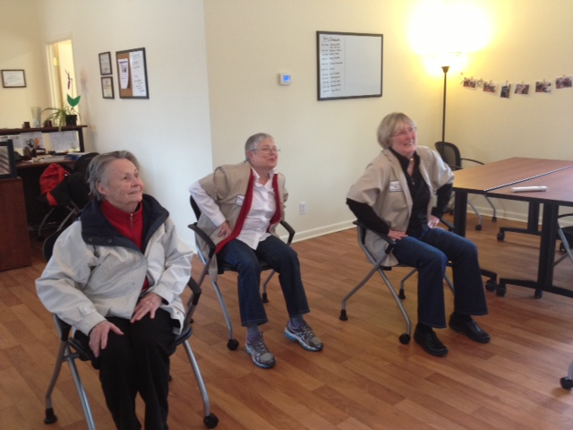
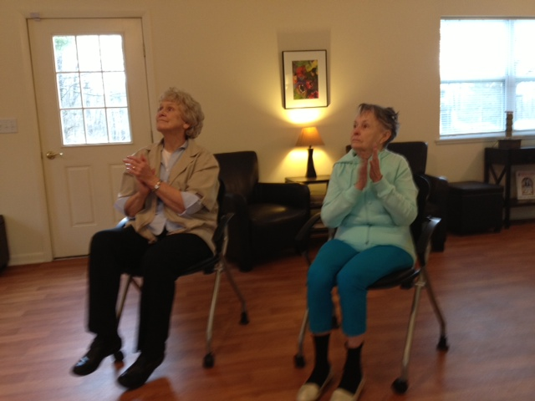
Supporting caregivers,
and their loved ones . . .
Exercise Activities
Benefits:
Improves Range of Motion
Retains Muscle Tone and Mobility
Helps them Sleep Better
Activities Include:
Chair Aerobics and Yoga
Walking
Dancing
Ball Toss
Wii Bowling

Slide 28
Outside Activities
Supporting caregivers,
and their loved ones . . .
Forster Woods is located on 10 ½ acres in the midst of a residential area in Williamston.
Benefits:
Allows participants to connect with nature
Be physically active
Feel unrestrained
Beneficial exposure to Vitamin D
Activities Include:
Walks
Bird Watching
Watering and/or observing flowers
Tea or coffee at the picnic table
Currently designing a Sensory Garden to be developed in the Spring of 2014

Slide 29
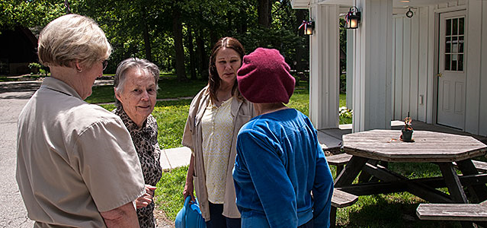
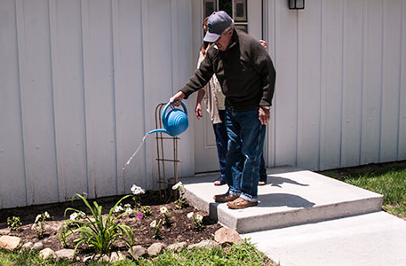
Supporting caregivers,
and their loved ones . . .

Slide 30
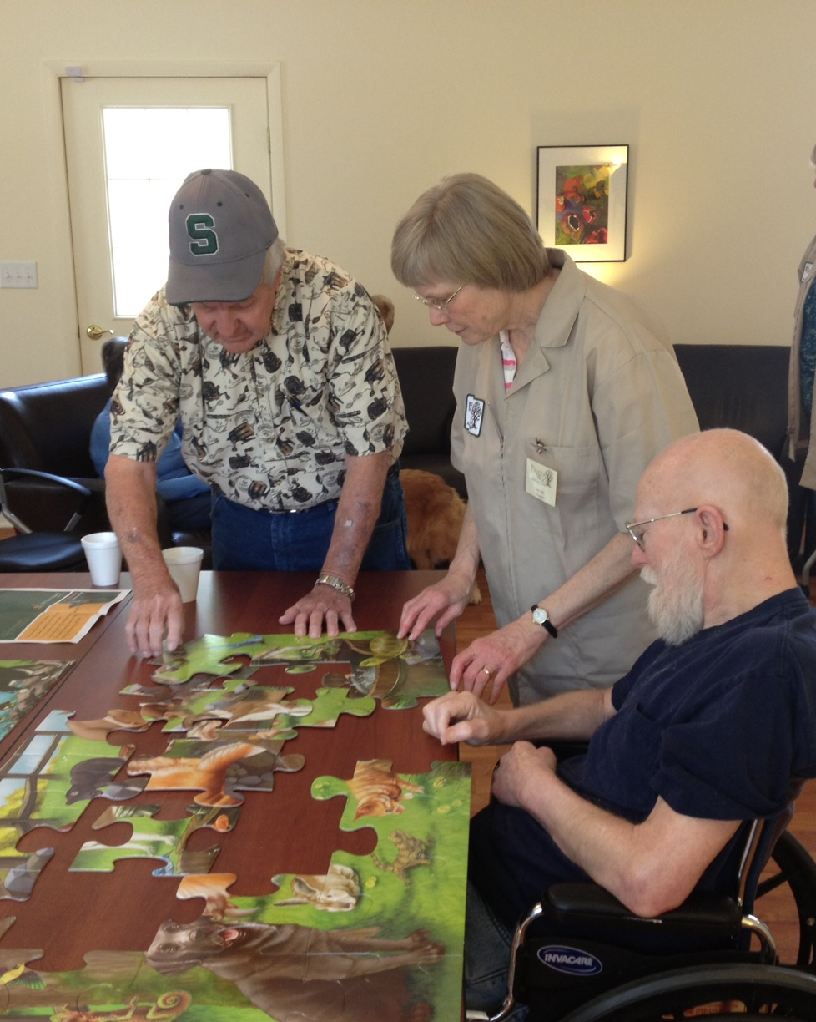
Supporting caregivers,
and their loved ones . . .
Cognitive Activities
Benefits:
Capitalizes on intact intellectual abilities
Relieve stress
Elevates mood
Gives them a sense of accomplishment and is a self esteem builder
Activities Include:
Complete a Word or Phrase
Puzzles
Sorting and Matching activities
Trivia
True or False

Slide 31
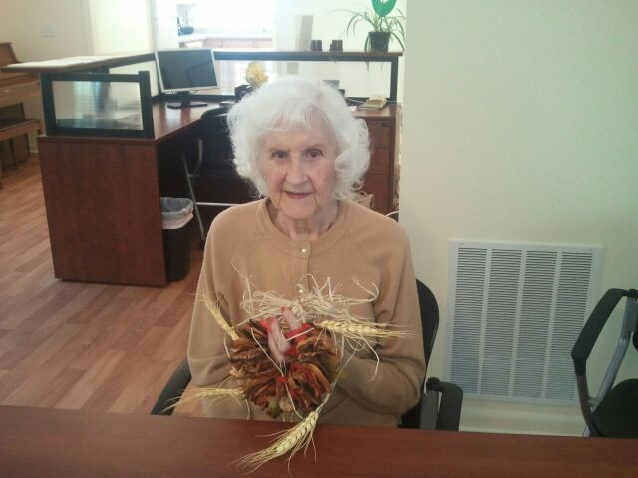
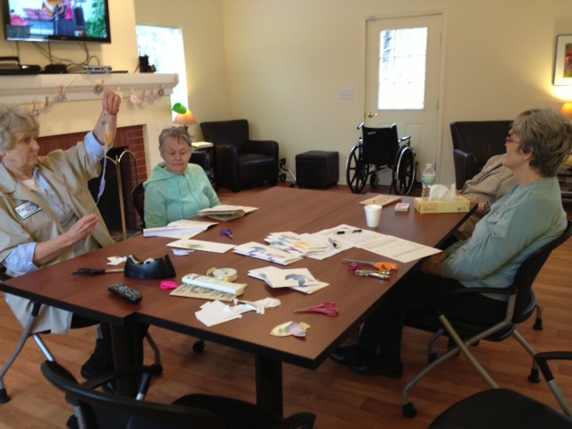
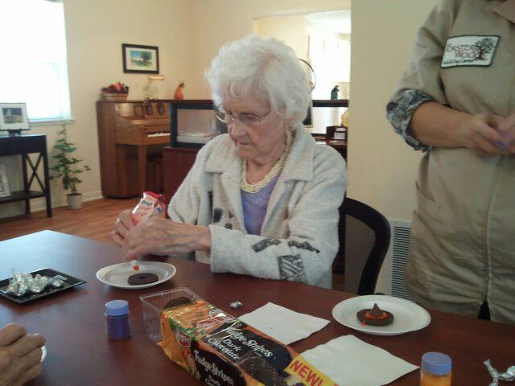
Supporting caregivers,
and their loved ones . . .
Creative Activities
Benefits:
Provides socialization
Memory stimulation
Sense of independence
Activities Include:
Crafts
Visual Arts
Culinary Activities

Slide 32
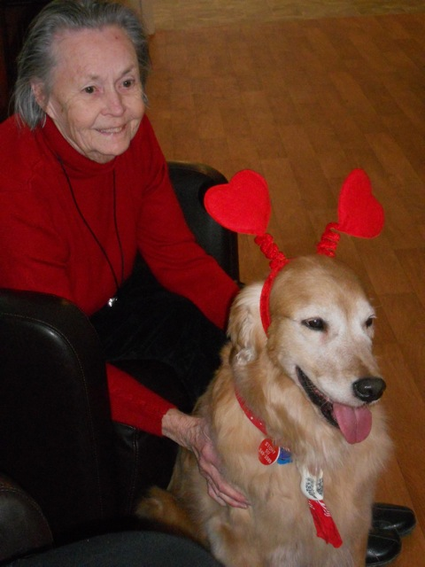
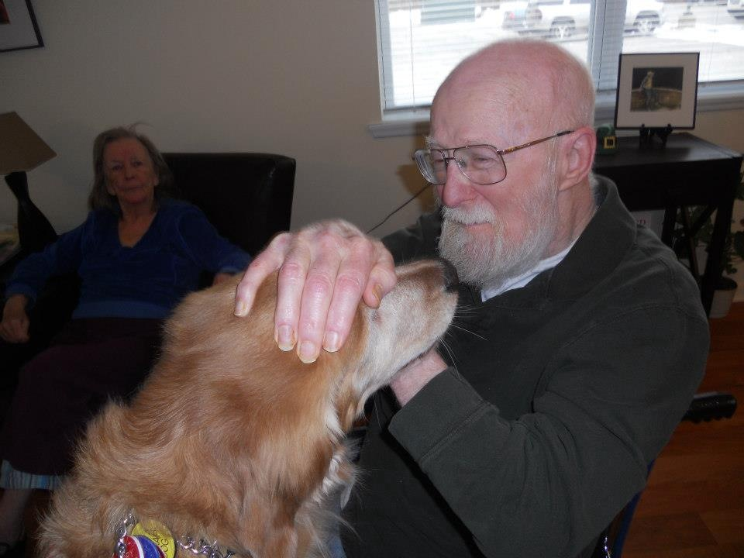
Supporting caregivers,
and their loved ones . . .
Sensory Activities
Benefits:
Promotes wellbeing
Maintains skills
Provides relaxation
Expresses emotions
Activities Include:
Pet Therapy
Aromatherapy
Bird Watching
Manicures
Horticulture

Slide 33
Animal Therapy
Supporting caregivers,
and their loved ones . . .
Stimulates social interaction and eases agitation
Therapy certified Golden Retrievers join us a couple times a week

Slide 34
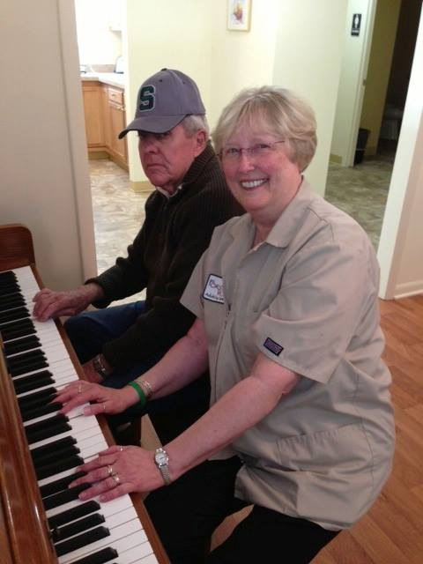
Supporting caregivers,
and their loved ones . . .
Music Activities
Benefits:
Reduces Stress
Enhances Memory
Improves Communication
Expresses Feelings
Activities Include:
Sing-a-longs
Playing Piano
Visiting Musicians
Name that Tune

Slide 35
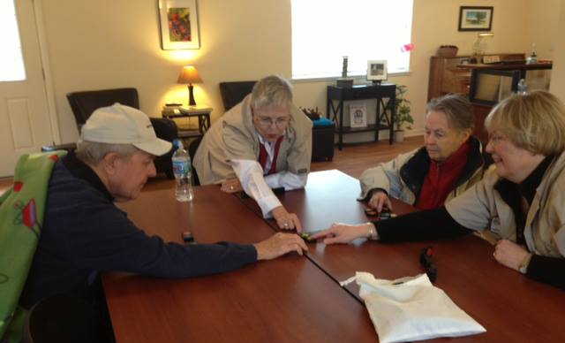
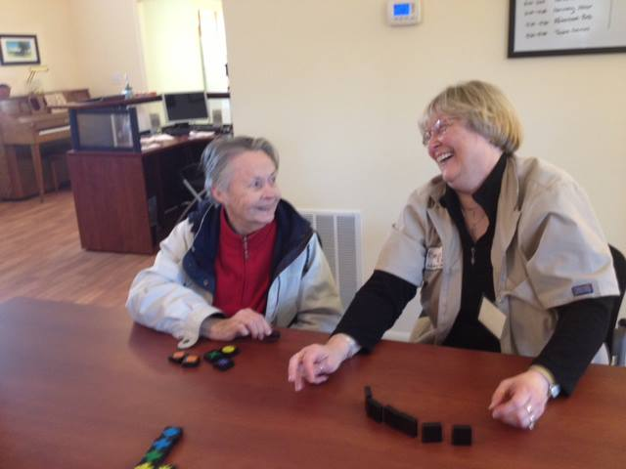
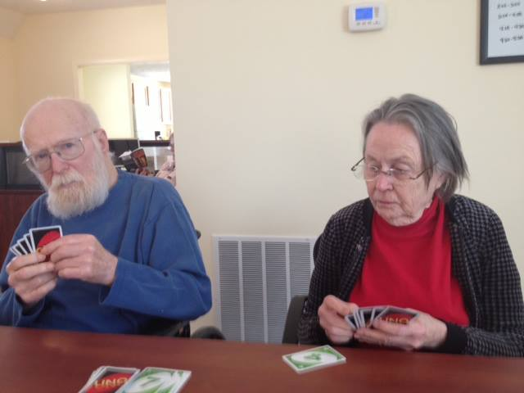
Supporting caregivers,
and their loved ones . . .
Table Games
Participants end the day with cards, bingo, checkers or dominos.

Slide 36
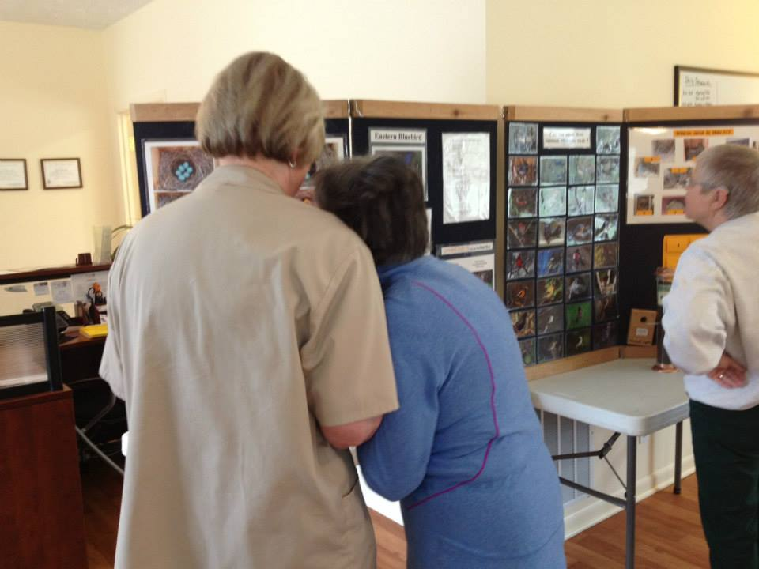
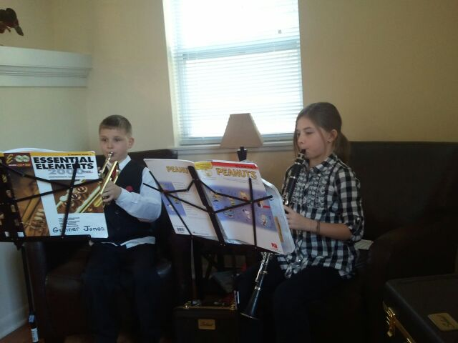
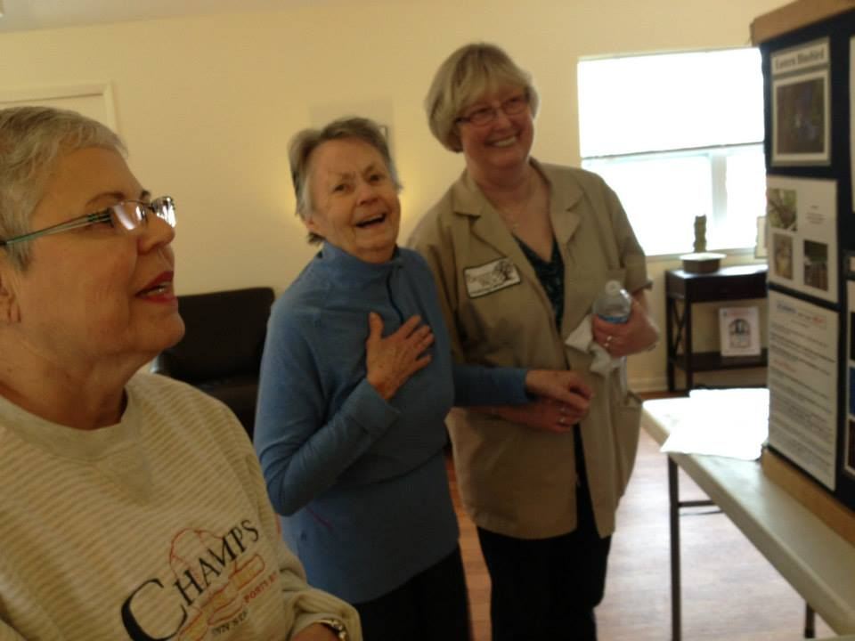
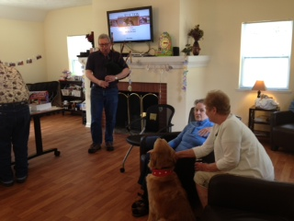
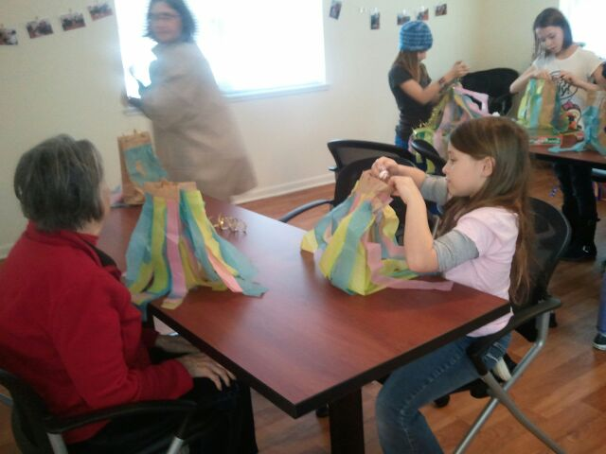
Supporting caregivers,
and their loved ones . . .
Community Visitors and Intergenerational Events
Occasionally we will have individuals from the community come in and share their talent or special interest with the participants.

Slide 40
Forster Woods

Slide 41
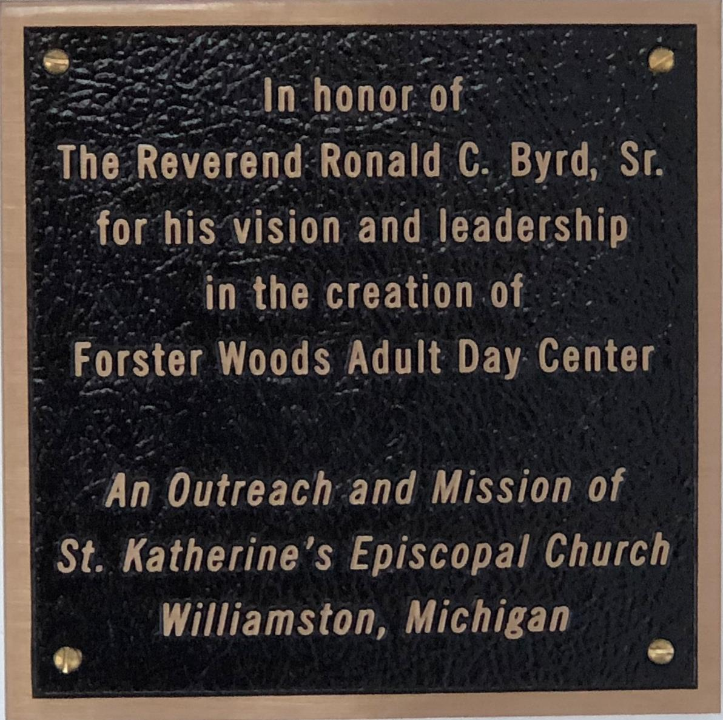
Supporting caregivers,
and their loved ones . . .

Slide 42
Missional Entrepreneurial Ministry
How To Start
Determining Community Needs
Considerations in selecting an Missional Program
Facility, Administrations, Operations & Finances
Where Do I Find Funding?
Program Services
Staffing and Documentation
Marketing

Slide 43
Missional Entrepreneurial Ministry
Determining Community Needs
Conduct a community needs assessment
Determine a potential market for the targeted service area
What is your target community?
Demographics of the community
Economic climate of the community
Major employers
Key Community Leaders
Other similar services available in the community

Slide 44
Missional Entrepreneurial Ministry
Determining Community Needs
Determining Community Needs
What transportation resources are there?
What are the referral sources?
Where will your mission be located?
What will be the funding sources?
Standards?
Licensure
State Standards
National Standards
Accreditations

Slide 45
Missional Entrepreneurial Ministry
Mission: Who are you called to serve?
Forster Woods’ Mission Statement
To support caregivers and their loved ones by providing safe, caring,
and reliable services for adults who would benefit from a compassionate environment, meaningful programming, and opportunities for socialization.

Slide 46
Missional Entrepreneurial Ministry
Vision: What do you hope to accomplish?
Forster Woods’ Vision Statement:
Forster Woods strives to be the provider of choice for home and community based services allowing our participants to remain in their homes and communities and by providing much need respite to their caregivers

Slide 47
Missional Entrepreneurial Ministry
Guiding Principals
What are your most important reasons for existing?
Forster Woods’ Guiding Principles are:
Forster Woods Adult Day Center is founded on a desire to help others in need.
Believe our employees are our most important assets.
To provide a great work environment and treat each other with respect and dignity.
To contribute positively to our communities.
Committed to being a fiscally responsible home and community based program.

Slide 48
Missional Entrepreneurial Ministry
Administration and Operations:
Establish an Discernment Team
Develop a Working Board of Directors
The development of an effective Board of Directors is essential to any non- profit organization. These individuals, if selected properly, can strengthen the organizations financial as well as operational functions tremendously.

Slide 49
Missional Entrepreneurial Ministry
Administration and Operations
 Develop a Working Board of Directors
 Choose Wisely!  Finance/Business  Strategic Planning  Law/Human Resources  Marketing/Fund Development  Political/Advocacy  Expertise/Leader  Consumer Family Member  Diversity
.

Slide 50
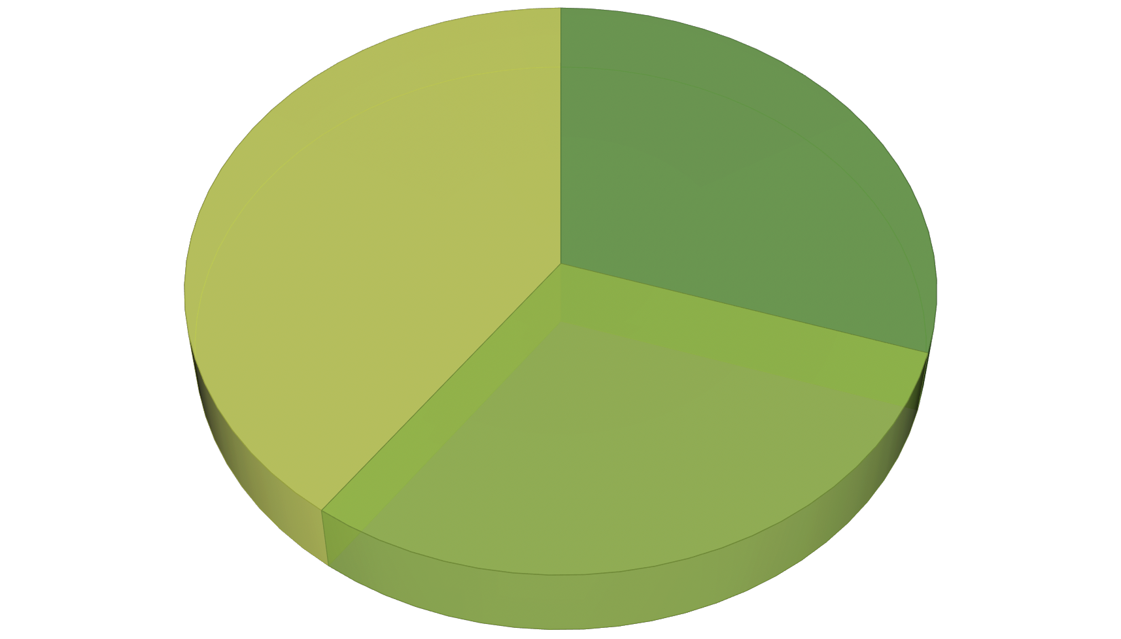
Missional Entrepreneurial Ministry
Finances:
DIVERSIFY YOUR REVENUE STREAM.
Program Income
Fundraising
Grants

Slide 51
Gathering of Leaders
Entrepreneurial Visionary Leaders
in the
Missionary Church
August 12, 2019
The Reverend Ronald C. Byrd, Sr.
The Episcopal Church
Missioner for Black Ministries

