Slide 1

This is Our Logo
We were founded as an Ecumenical Sunday School &
Currently most of our programming & Outreach focuses around Families & Children

Slide 2
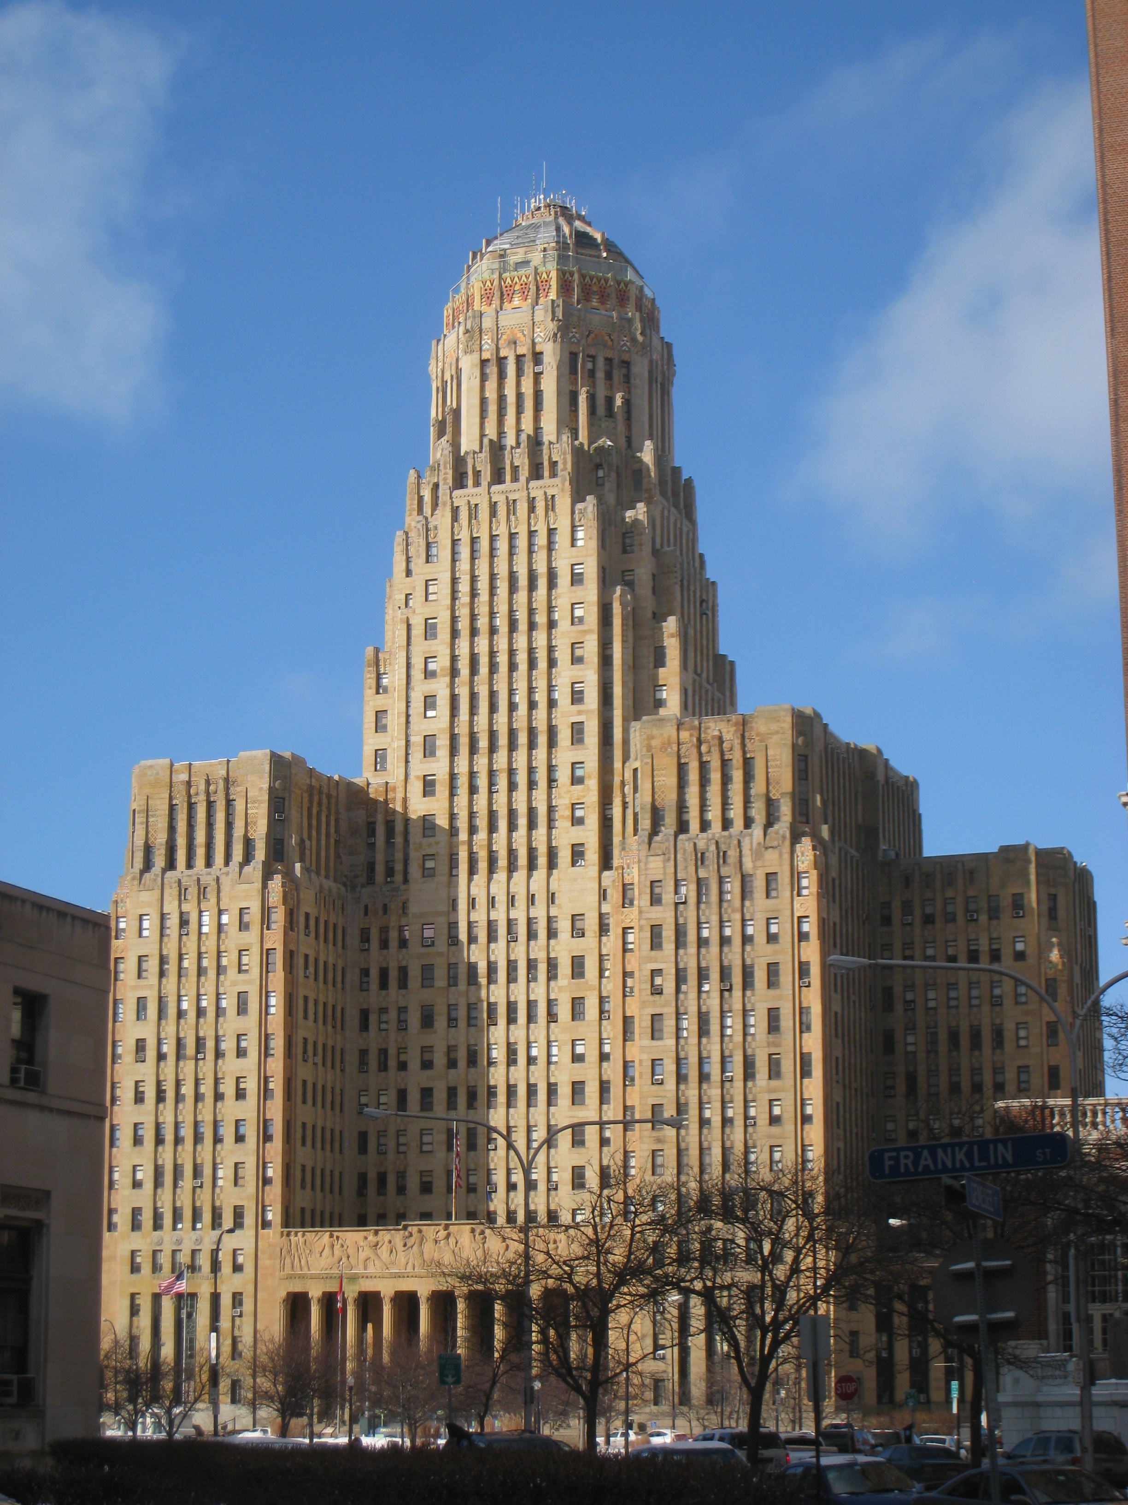
We Are a Suburb of Buffalo
Buffalo has always been a place immigrants have come from Irish, Greeks & Italians when the Erie canal was being dug to Burmese, Thai, Central American & African immigrants today
Buffalo Has also been a Major Refugee Resettlement City for more than 30 years

Slide 3
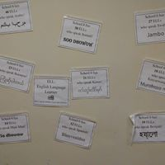
This is from Our
Partner School
There are English
Language Learners who Speak 15 Languages in our
Partner School

Slide 4
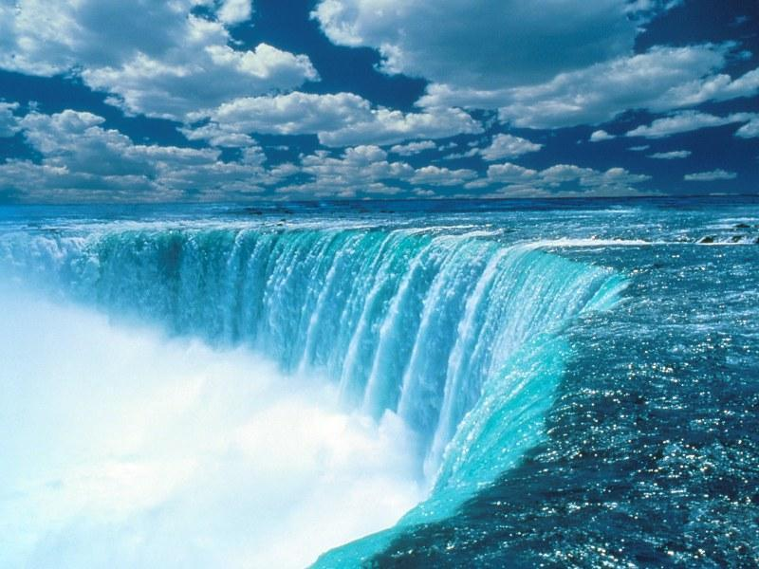
We Are a Border Region
We are 30 Miles from Niagara Falls, and
10 Miles from the Peace Bridge parishioners and their Family members are part of the Border Patrol and Ice.

Slide 5
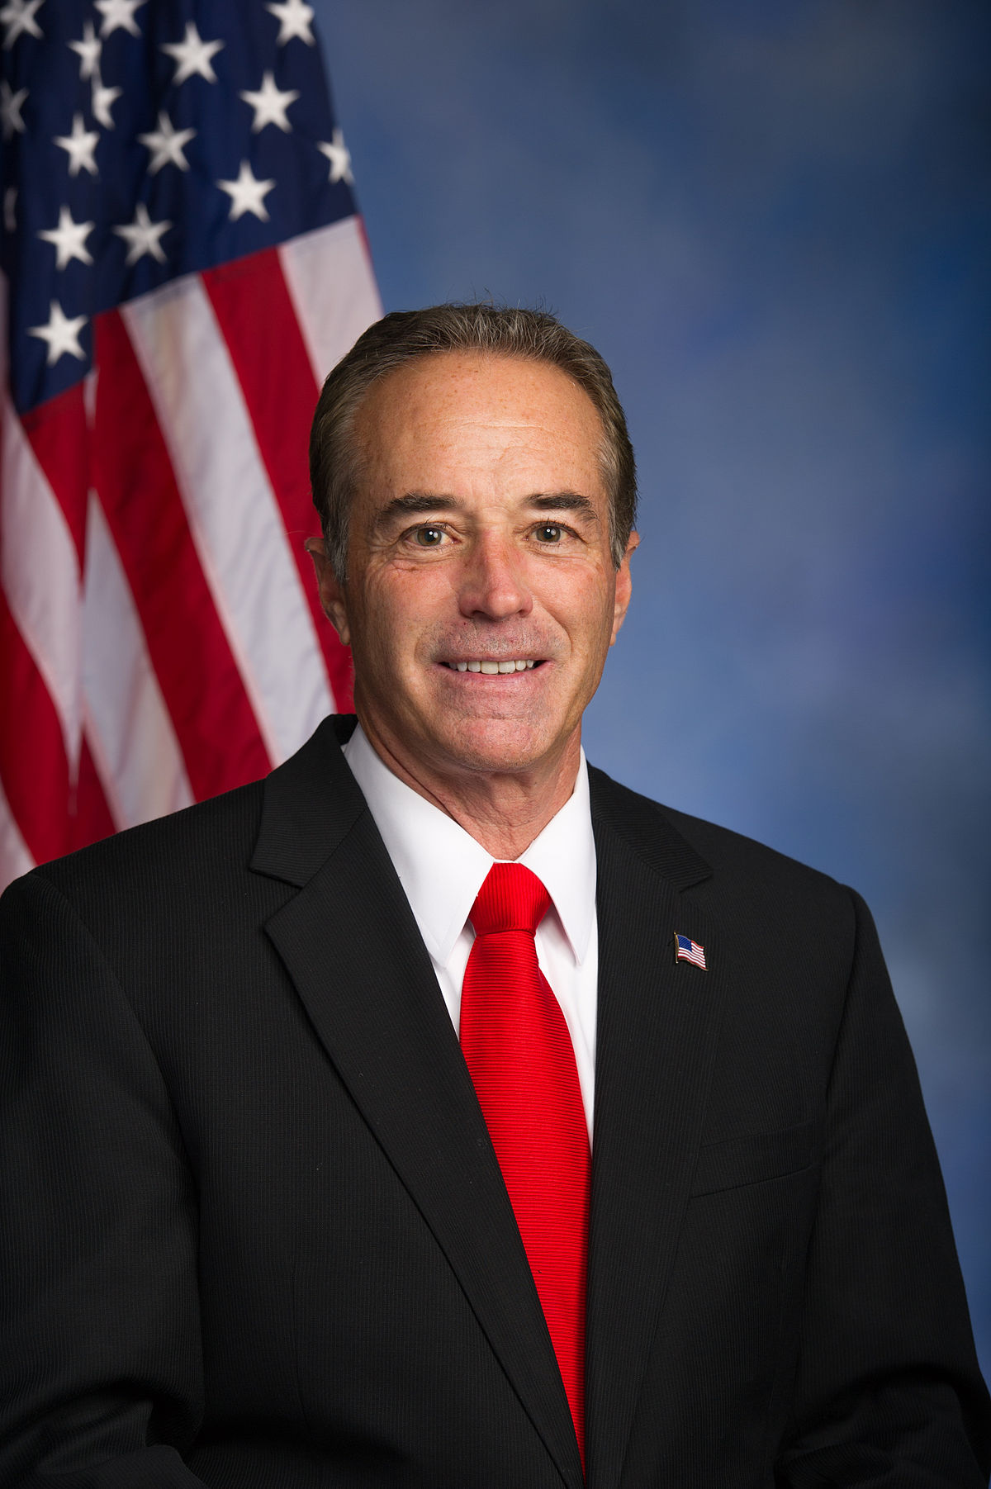
This is our Congressman, Chris Collins.
He Was the First member of Congress to Endorse Donald Trump. We was Re-elected last Year Even though he was under indictment for Insider Trading.
Some Parishioners Voted For Him.

Slide 6
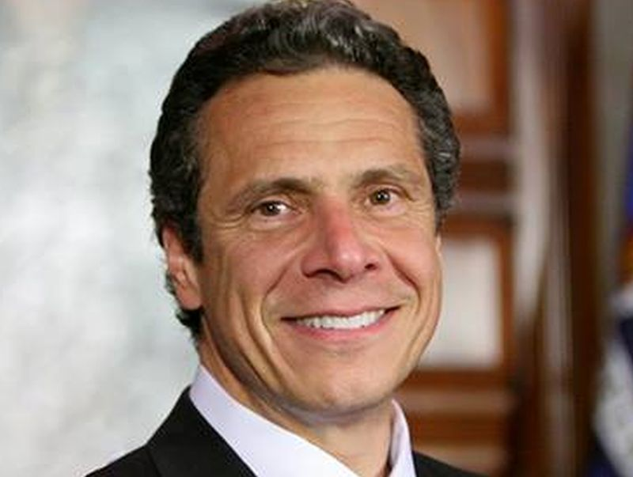
This is our Governor, Andrew Cuomo. He is one of the most liberal governors in the country. Parishioners voted for him.

Slide 7
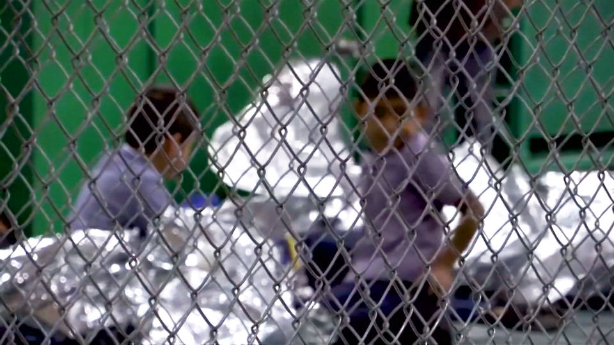

Slide 8
Discussion after Church
Gathering of Information
Sharing of Ways to respond
Making space for a variety of views
Assuming Goodwill of those who disagree

