Slide 2
Coaching for Church Leaders
A Powerful Tool for Developing
♦️ Committed
♦️ Motivated
♦️ Joyful
♦️ Lifelong
♦️ Growing
Disciples of Jesus

Slide 3
What We’ll Cover
A few core principles of (discipleship) coaching
Some real-life examples on the diocesan and parish level
A basic coaching approach you can use right now
Questions generated by the talk

Slide 4
Backed Up By Experience
Seven years developing a coaching culture in the Diocese of New Jersey
40+ coaches, clergy and lay, trained in the approach you’ll learn today
Dozens now being coached regularly
Real-life clergy and congregations transformed

Slide 5
Coaching Focused on One Purpose
The primary purpose of the Church is to develop committed, lifelong followers of Jesus - people who are committed to living and loving like Jesus and helping others to do the same. Coaching does this directly.

Slide 6
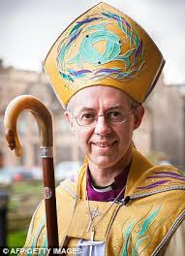
One Purpose Worldwide

Slide 7
Discipleship Coaches
Are not mentors, consultants, therapists or spiritual directors - coaching is different
Come alongside as a companion, like Barnabas
Affirm the creativity, resourcefulness and wholeness of those they coach: coachees can and must build their own answers and actions
Commit themselves to the development of those they coach as disciples of Jesus

Slide 8
Discipleship Coaching
Responds to opportunity and felt need - has a broad application
Demands accountability and has an action focus - so people can see their progress.
Demands highly developed listening skills
Creates a congregational culture where everything is focused on formation.

Slide 9
Four Lessons from Real Life:
Trinity Moorestown, NJ
Lesson One Coaching creates a culture where people see the work of God in their daily lives, and are supported in actively responding to the work and call of God.

Slide 10
Four Lessons from Real Life:
Trinity Moorestown, NJ
Lesson Two Coaching creates and strengthens confidence in the presence of Jesus and the work of the Spirit because we assume that as a starting point

Slide 11
Four Lessons from Real Life:
Trinity Moorestown, NJ
Lesson Three Coaching builds richer community life in which people really begin to understand themselves as committed followers of Jesus.

Slide 12
Four Lessons from Real Life:
Trinity Moorestown, NJ
Lesson Four Coaching keeps the main thing the main thing: A focus on mission and purpose, and developing people and communities with discipleship at the center.

Slide 13
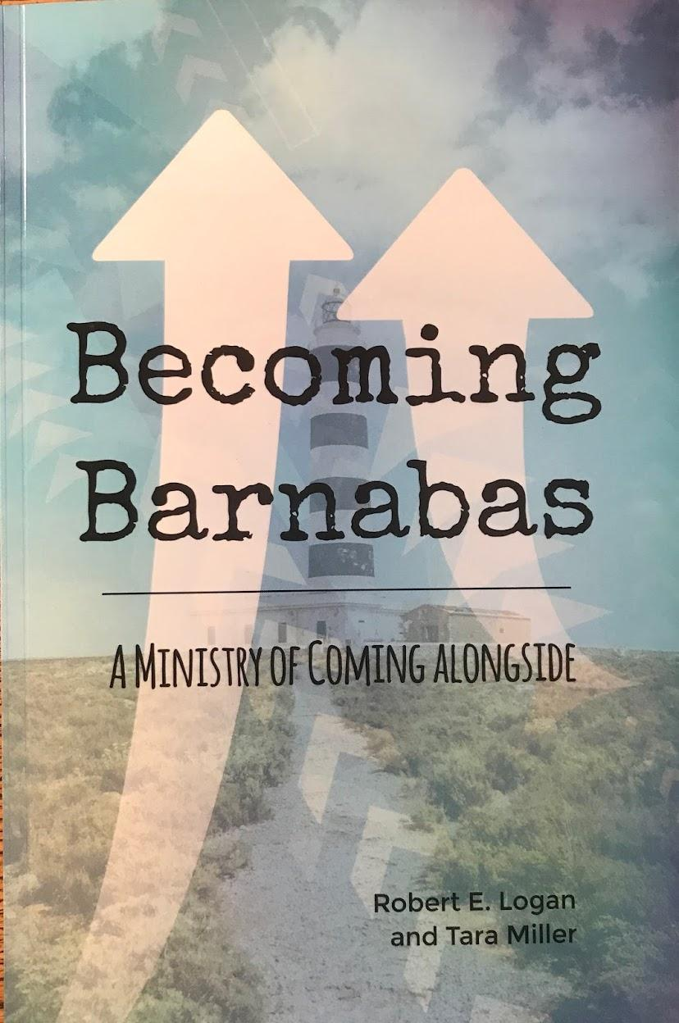
The Barnabas Questions
How are you?
What do you have to celebrate today?
What challenge are you facing?
What do you want to do about it?
Who can I help you?
How can I pray for you?

Slide 14
Reflection on the Experience
Notes:
Started 5 years ago

Slide 16
Appendix Information

Slide 17
7 Reasons to Coach as a Church Leader
It helps your people to grow in their Christian faith,
Every ministry in the church is energized by a personal experience of transformation in Christ. It provides needed nourishment to service.
It provides support, accountability, and a feeling of progress.
It naturally includes the action-reflection approach – one of the most powerful sources of Christian growth.
It creates a space for Jesus to liberate people.
People can see their progress and celebrate it.
We grow personally when we help others grow, making us (clergy, that is, more authentic, grateful and effective).

Slide 18
Useful Links on Coaching for Discipleship
Logan Leadership, Pasadena, California Link
Holmes Coaching Group, Maryland Link
Gold standard coaching certification (secular but very useful): International Coaching Federation Link Link
Diocese of New Jersey Website (coaching in the diocesan setting) Link

