Slide 1




2023 Annual Report
The Gathering of Leaders

Slide 2

Table of contents
1
From the Board Chair
8
2023 Donors
2
From the Director
10
2024 Board
2023 Gatherings &
Travels
Looking Ahead
3
13
5
2023 Financials

Slide 3
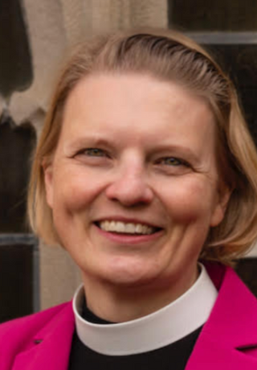

From the Board Chair
As the context around us keeps shifting, the core work and purpose of GOL keeps growing clearer: to connect gospel-focused leaders to foster creativity, strengthen hope, make spaces for insight and innovation, and learn from one another – all of which fuels and feeds the life and growth of the church in the mission of Jesus.
2023 saw the continued expansion of our lay leader network – a powerful force for renewal, growth, and strength throughout the church and God’s world, along with the broadening of all our networks as we shift toward invitation and discernment as our network entry points for leaders, rather than nomination from within. This helps us respond to, welcome, and serve often underrepresented leaders, from whose work the church often finds life-giving transformation.
We have also been discerning and dreaming – in the board and with our executive director and staff – about new ways to partner and connect with other networks within the church to offer GOL’s unique and powerful peer-learning and creative gifts to support and develop leaders across the church.
I’m grateful to all of you – sharers and stakeholders in this particular field of God’s mission – as you continue to invest your creativity, connections, financial resources, time, prayer, talent and faith in the missionary call of Christ, and in the Gathering of Leaders.
Blessings,
Emily
1

Slide 4
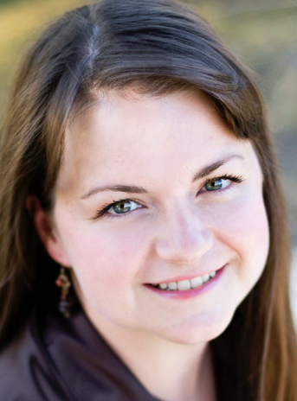
From the Executive Director
As Executive Director of The Gathering of Leaders, it is with immense gratitude that I present our annual report for 2023. In true Gathering of Leaders fashion, this year had a big ‘first’. In continuation of our work to be a more diverse and inclusive organization, GOL shifted from being an invitation only network to one where leaders can inquire for themselves. This openness and availability is already strengthening our lay and clergy leaders and I am grateful to our Board of Directors for their commitment to make this happen.
Also, our dedication to nurturing current and future leaders in the Episcopal Church remained unwavering. In 2023 we grew both our clergy and lay leader networks with Gatherings held in Chicago, Maryland, North Carolina, and San Francisco, connecting leaders from across the nation. By investing in leadership development at all levels, we aim to create a ripple effect that extends far beyond our immediate reach, shaping the changing church of the future.
Looking ahead, we are energized by the possibilities that lie before us. As we continue to adapt to a rapidly changing world, we remain dedicated to our core values of hope, innovative creativity, and peer learning. Together, we will build upon the successes of the past year and seize the opportunities of tomorrow, reaffirming our commitment to the Great Commission. Thank you to our dedicated team, partners, and supporters for their unwavering commitment to our shared vision. With your continued support, we will chart a course towards a brighter future for The Gathering of Leaders and the leaders we serve.
~ Haley
2

Slide 5

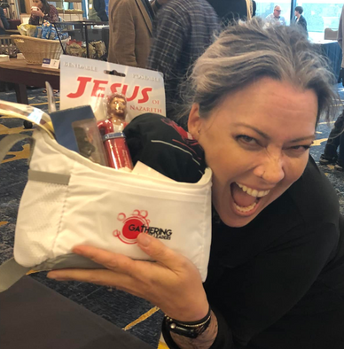
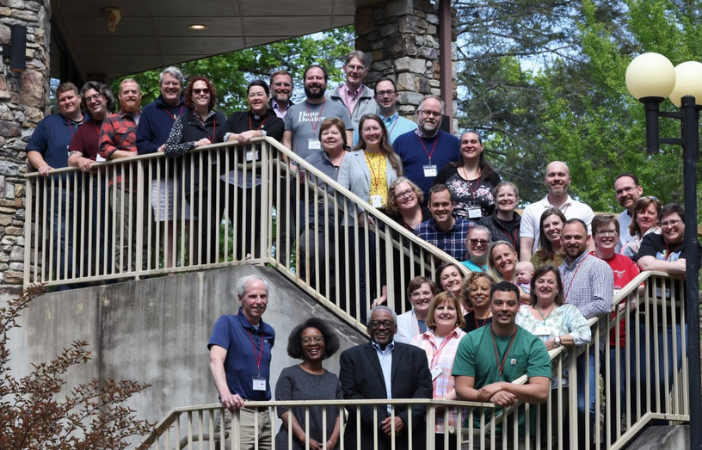
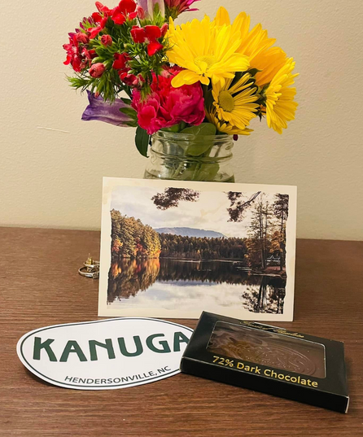
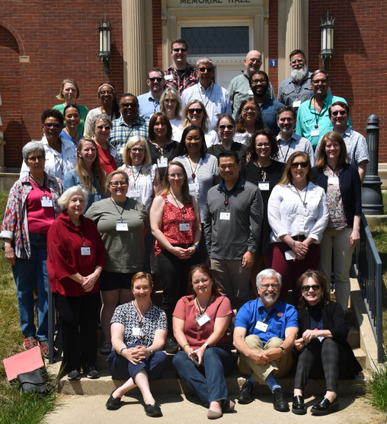
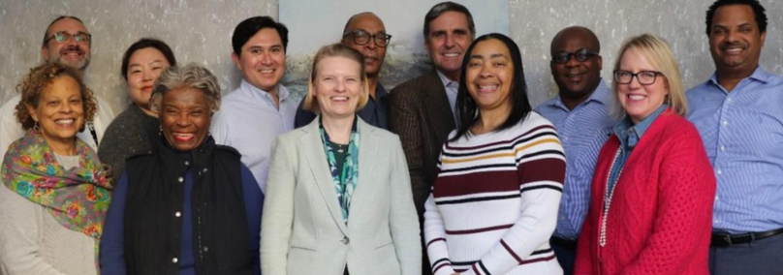
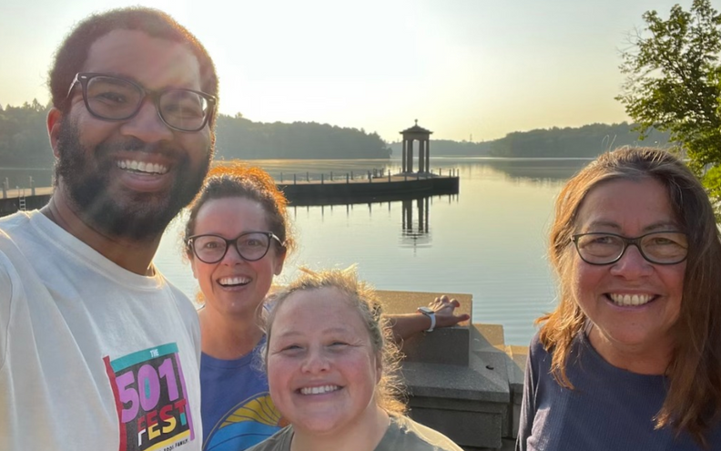
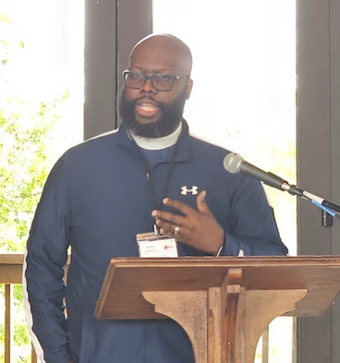
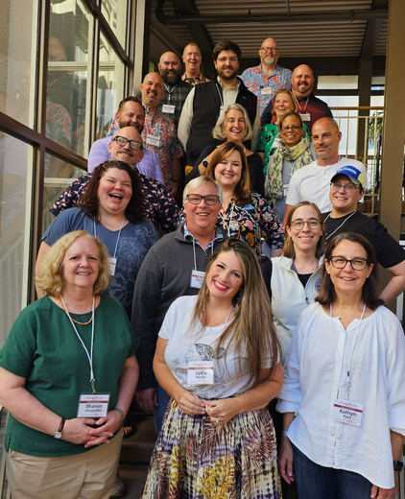
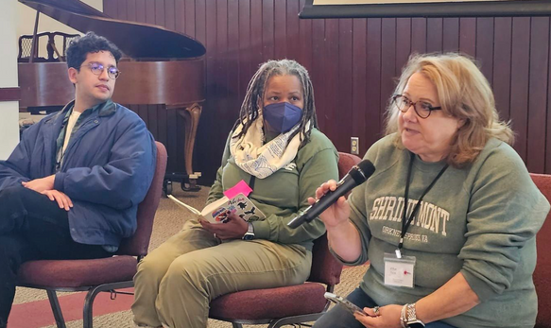
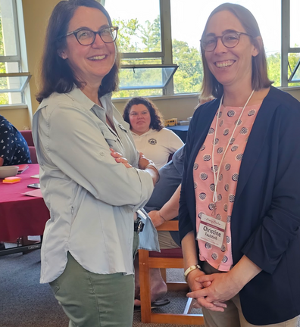
2023 Gatherings & Travels
2023 saw the continued growth and integration of the new Lay Leader network at GOL while our original network expanded on its rich beginnings.
GOL @ EPN
Clergy Gathering @ Kanuga
GOL Board in Texas
Lay Gathering @ Chicago
Clergy Gathering @ Maryland
Clergy Gathering @ San Francisco
3

Slide 6
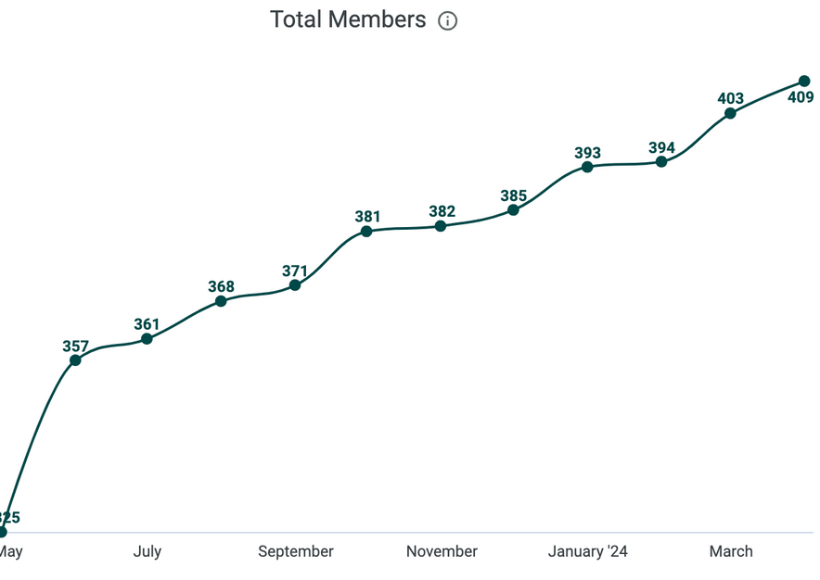

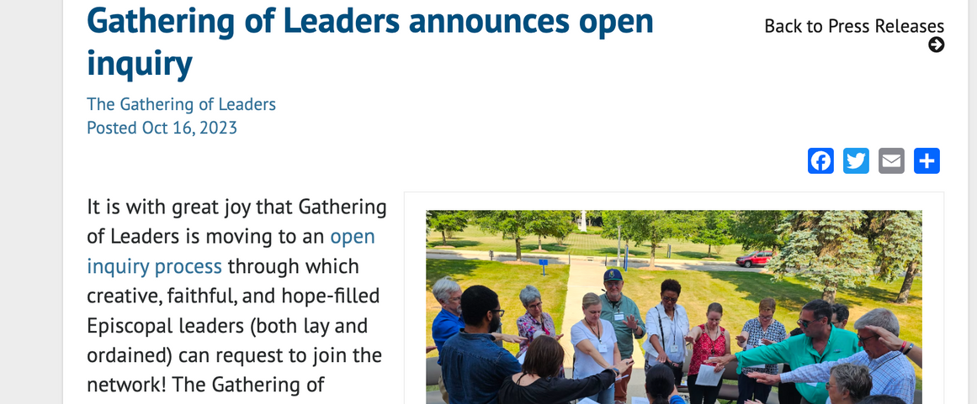
Online Community
Mighty Networks and Facebook have seen exponential growth this year through targeted messaging, regular content and the open inquiry launch.
With 23 shelves in our curated resource library (and more being added all the time!), our GOL Participants expand our peer-learning methods in a digital format.
Open Inquiry Launch
Originally The Gathering of Leaders grew through a peer-nomination system which served well in those early, grass-roots stages of the network. In 2023 the network opened up to all interested individuals seeking peer-learning towards mission and evangelism, believing that doing so will further the work of GOL’s ongoing diversity, equity, and inclusion efforts.
4

Slide 7
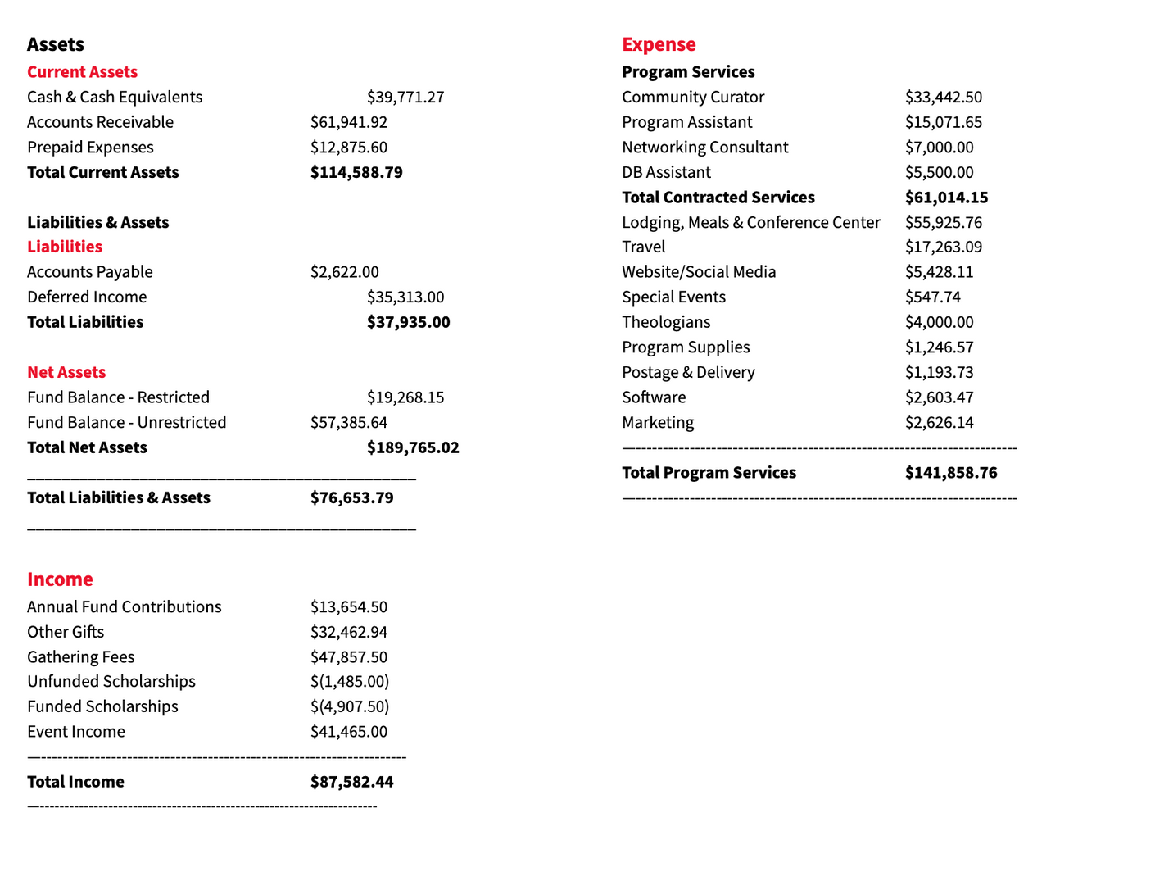
Statement of financial position
as of 12/31/2023
2023 financials
5

Slide 8
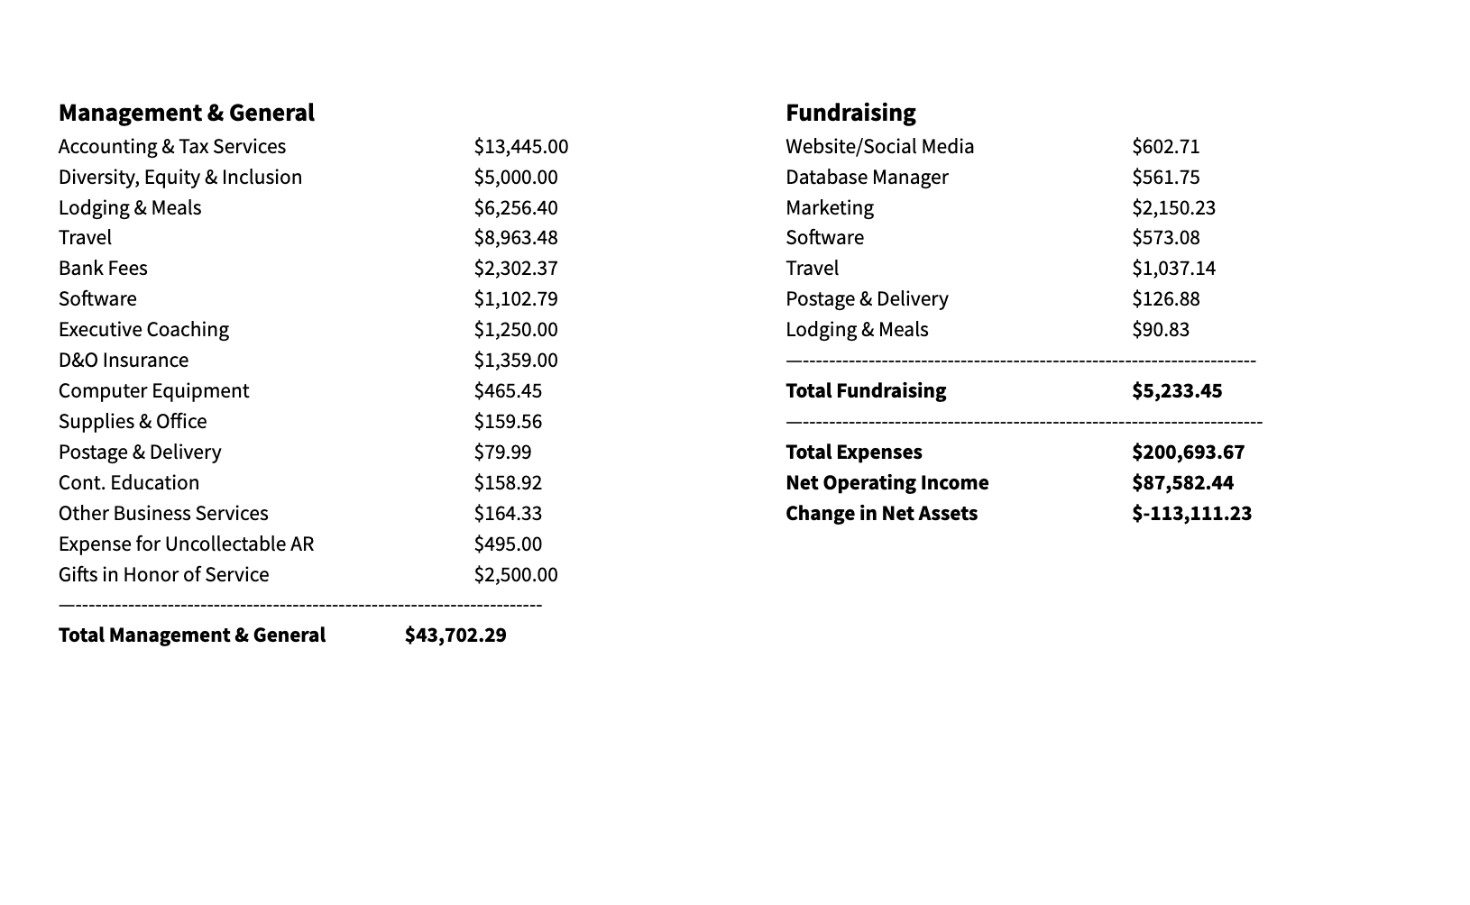
2023 financials Cont.
6

Slide 9
Donors - Institutions
All Saints’ Episcopal Church
All Saints’ Episcopal, Austin
Christ Church, Greenwich
Diocese of Central New York
Diocese of Louisiana
Diocese of Maryland
Diocese of Massachusetts
Diocese of North Carolina
Diocese of Northwest Texas
Diocese of Pennsylvania
Diocese of Rhode Island
Diocese of San Diego
Diocese of Southwest Florida
Diocese of Spokane
Diocese of West Tennessee
Diocese of West Texas
Diocese of Western Massachusetts
Episcopal Church in Connecticut
St. John's Episcopal, Memphis
St. Mark's, Beaumont
St. Matthias' Episcopal Church
St. Michael's Episcopal, Bristol
Trinity Church Wall Street
Virginia Theological Seminary
8

Slide 10
Donors - Individuals
Alexander, Sharon
Allen, Frank
Bader-Saye, Scott
Bankey, Haley
Bartz, Jimmy
Brown Snook, Susan
Burrus, John
Cipolla, Angie
Condon, Josh
Cox, Nancy
Cristiano, Kevin
Cutter, Irv
Davis-Lawson, Karen
Demo, Gar
Pollard, Diane
Dunlap, Mary Balfour
Eller, Skip
Faulstich, Christine
Gray, Duncan
Hay, Daryl
Holcombe, Matthew
Japtok, Ruth
Johnson Russell, Tracy
Johnson, Lydia
Kelly, Alisa
Kim, Yein
Lesesne, Gray
Loy, Reed
Lucas, Maureen
Martin, Grant
Martin-Currie, Jamie
Matthews, Westina
McKone-Sweet, Mark
Melchionna, Elizabeth
Mellott, Emily
Mendez, Troy
Merchant, Wilmot
Molly Carnes
Osborne, Laura
Paul, Marcea
Piedfort, Mark & Pam
Poling, Jason
Raining, Hillary
Reyes, Mildred
Rickel, Greg
Sramek, Tom
Tankersley, Rebecca
Taylor, Jemonde
Dephouse, Jon
Roaf, Phoebe
Kendrick, Russell
Van Niel, Noah
Veit, Rick
WIlson, Jeffrey
Lewis, Laurie
9

Slide 11
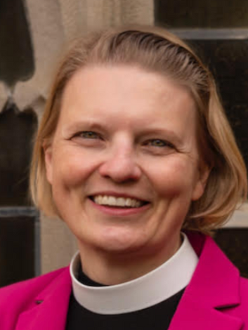
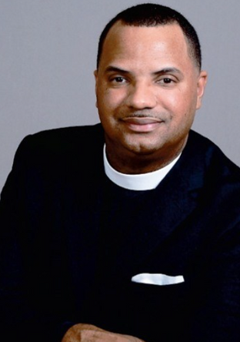
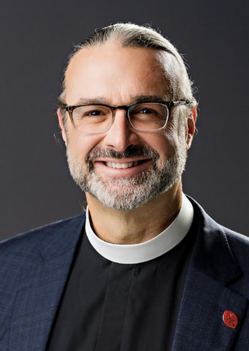
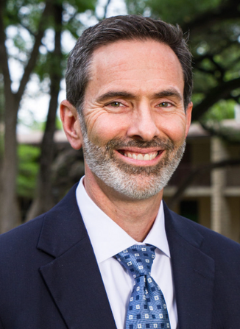
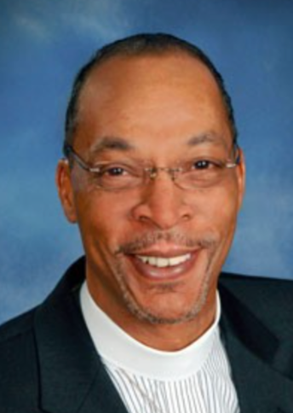
2024 Board
The Rev. Emily A. Mellott
Board Chair, GOL
Rector, Trinity Episcopal Church, Moorestown, NJ
The Rev. Robert Jemonde Taylor
Treasurer, GOL
St. Ambrose Episcopal Church, Raleigh, NC
The Rev. Kirk Berlenbach
Secretary, GOL
Canon for Growth & Development
Diocese of Pennsylvania
Norristown, PA
Dr. Scott Bader-Saye
Academic Dean
Seminary of the Southwest
Austin, TX
The Rev. Ronald C. Byrd, Sr.
Missioner for African Descent Ministries
The Presiding Bishop’s Staff
New York, NY
10

Slide 12
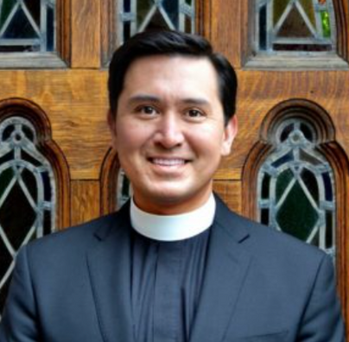
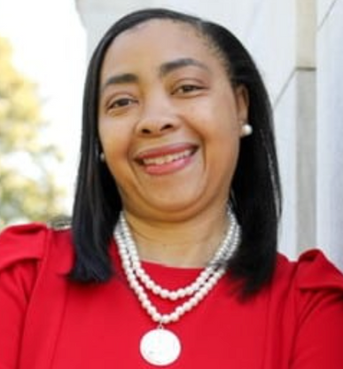
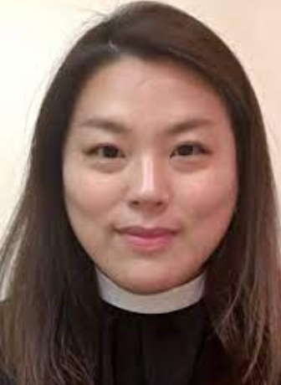
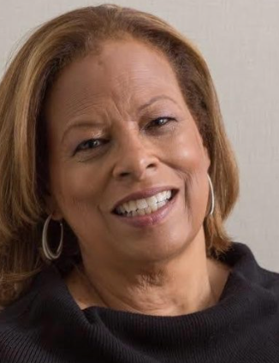
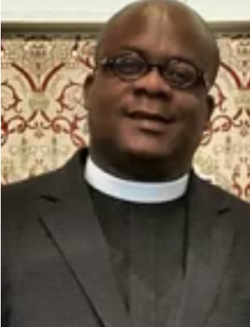
2024 Board
The Rev. Canon Michael Horvath
Rector, St. Michael’s Episcopal Church, Bristol, RI
Ms. Alisa Kelly
Canon of Finance & Administration, Diocese of West Tennessee, Memphis, TN
The Rev. Yein Kim
Priest for Congregational Life, Trinity Wall Street, New York City, NY
Dr. Westina Matthews
Trustee, Berkeley Divinity School at Yale, Savannah, GA
The Rev. Emmanuel Mercer
Rector
Christ Episcopal Church
Columbia, MD
10

Slide 13
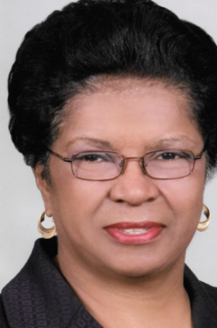
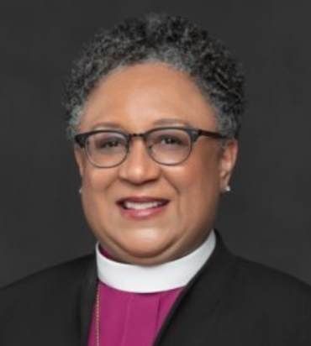
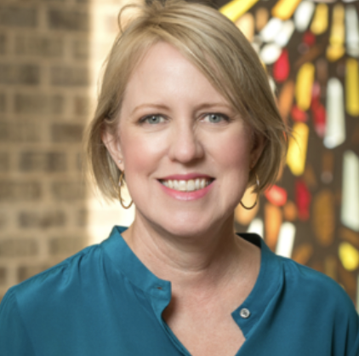
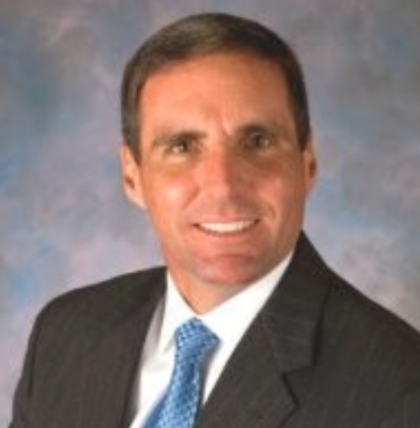
2024 Board
Ms. Diane Pollard
Member of Executive Council
The Episcopal Church
New York, NY
The Rt. Rev. Phoebe A. Roaf
Bishop
Diocese of West Tennessee
Memphis, TN
Ms. Anne Schmidt
Search Consultant
Albuquerque, NM
Mr. Jeffrey Wilson
Senior Regional Vice President,
Radio One
Washington, D.C.
12

Slide 14
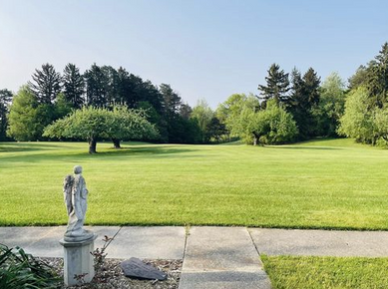
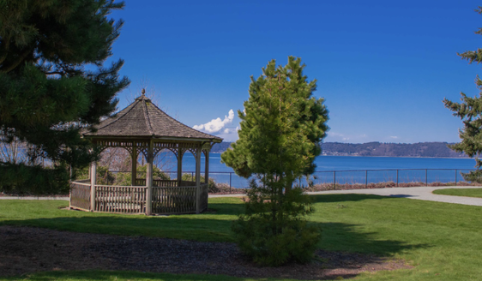

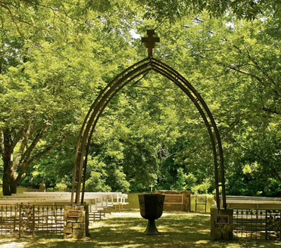
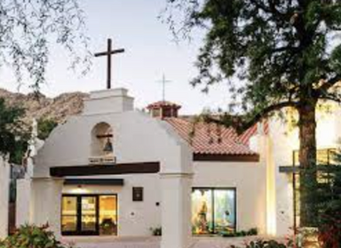
Looking ahead: 2024
Clergy Gathering at St. Francis, Michigan
Clergy Gathering at Dumas, Washington
GOL on the ground at GenCon24
Lay Gathering at St. Columba, Memphis
2024 Theme: Mission in the New Reality
Recent years, including the Covid-19 pandemic and global and national events, have brought the church into new and often post-traumatic contexts for mission, ministry, and evangelism. How have these changes impacted the way you meet Jesus, proclaim the gospel, and form disciples in your context? What failures and successes have you learned from during times of acute change? What burdens must we lay down to make space for renewal, refreshment and hope for ourselves and for others? Where do you find – or offer – creativity, innovation, growth in the current moment, and for the future?
Lay Gathering at Franciscan Renewal Center, Scottsdale
13

